Slide 1
Aesthetic Design Award
ClockPetals
WindNebula
Zheng Zhou, Hui Tang, Wenjie Wu
Computer Graphics Technology, Purdue University
IEEE VIS 2017 VAST Challenge Workshop
Sunday, October 1st, 2017

Slide 2
Team
One team of participants for two mini challenges
Developers
Zheng Zhou
Hui Tang
Siji Wang
Wenjie Wu
Designers
Wenjie Wu
Aijun Huang
Yafeng Niu
  Directors
  Dr. Yingjie Victor Chen
  Dr. Zhenyu Cheryl Qian

Slide 3
ClockPetals
Interactive Sequential Analysis on Traffic Patterns for Mini-Challenge 1
From Spatio-Temporal Perspective
Notes:
Vehicles pass through points of interests can be seen as a sequence of events happened under a spatial context. In this case of mini-challenge 1, a vehicle accessed the park area must have visited a few checkpoint sites with sensors recording each visit and therefore preserve both spatial and temporal dimensions. So we abstracted the entire problem to an sequential analysis of traffic patterns and anomalies from spatial and temporal perspective.

Slide 4
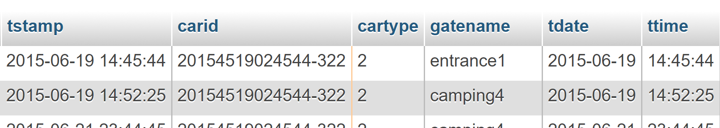
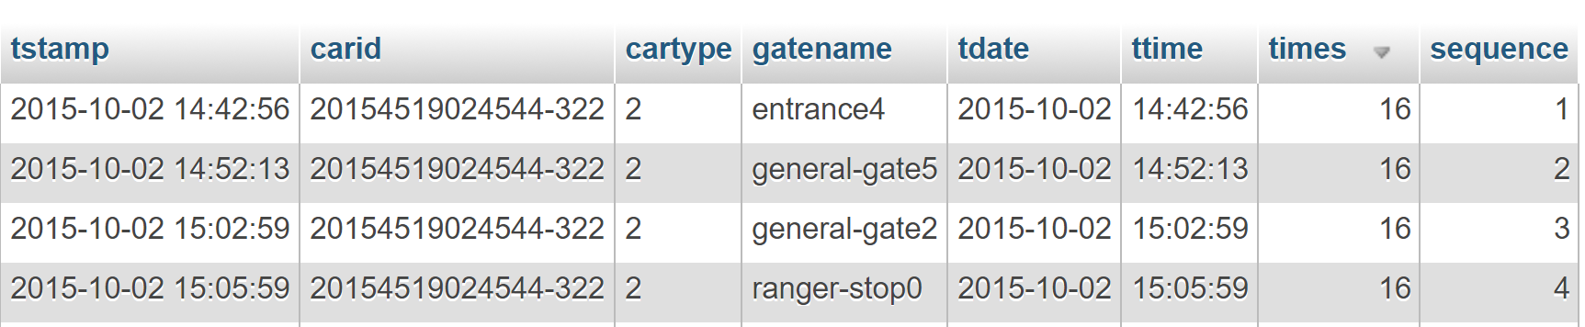
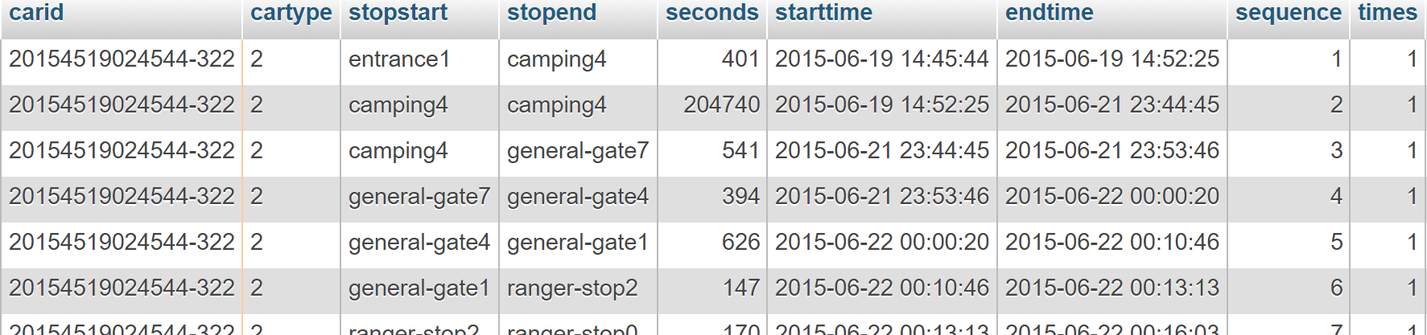
Data analysis and preprocessing
Spatio-Temporal Sequential Events Problem
Original Dataset
Sequence and times added
Sequential segments added
Notes:
The original dataset can be summarized to entries of vehicles’ timestamped visitings to checkpoint sites.
To better reveal the sequential characteristics, we processed the dataset and obtained a couple of more dimensions. For each vehicle , we had its entire visiting sequence of one visit from entering the park to surrendering the ticket, followed by which stop this site was in the sequence for each entry in the original dataset. Meanwhile we also calculated for how many times this vehicle has visited the park area.
Furthermore, based on the sequences, we processed the dataset to generate new data tables from the perspective of the checkpoint sites. We snapshot each segment of each sequence and got entries of such segments, which indicates its starting and ending checkpoint sites and corresponding timestamp, as well as the staying duration. The new data table brought an advantage of inspecting the checkpoint sites where vehicles would spend some amount of time, for example the camping sites and the ranger stops.

Slide 5
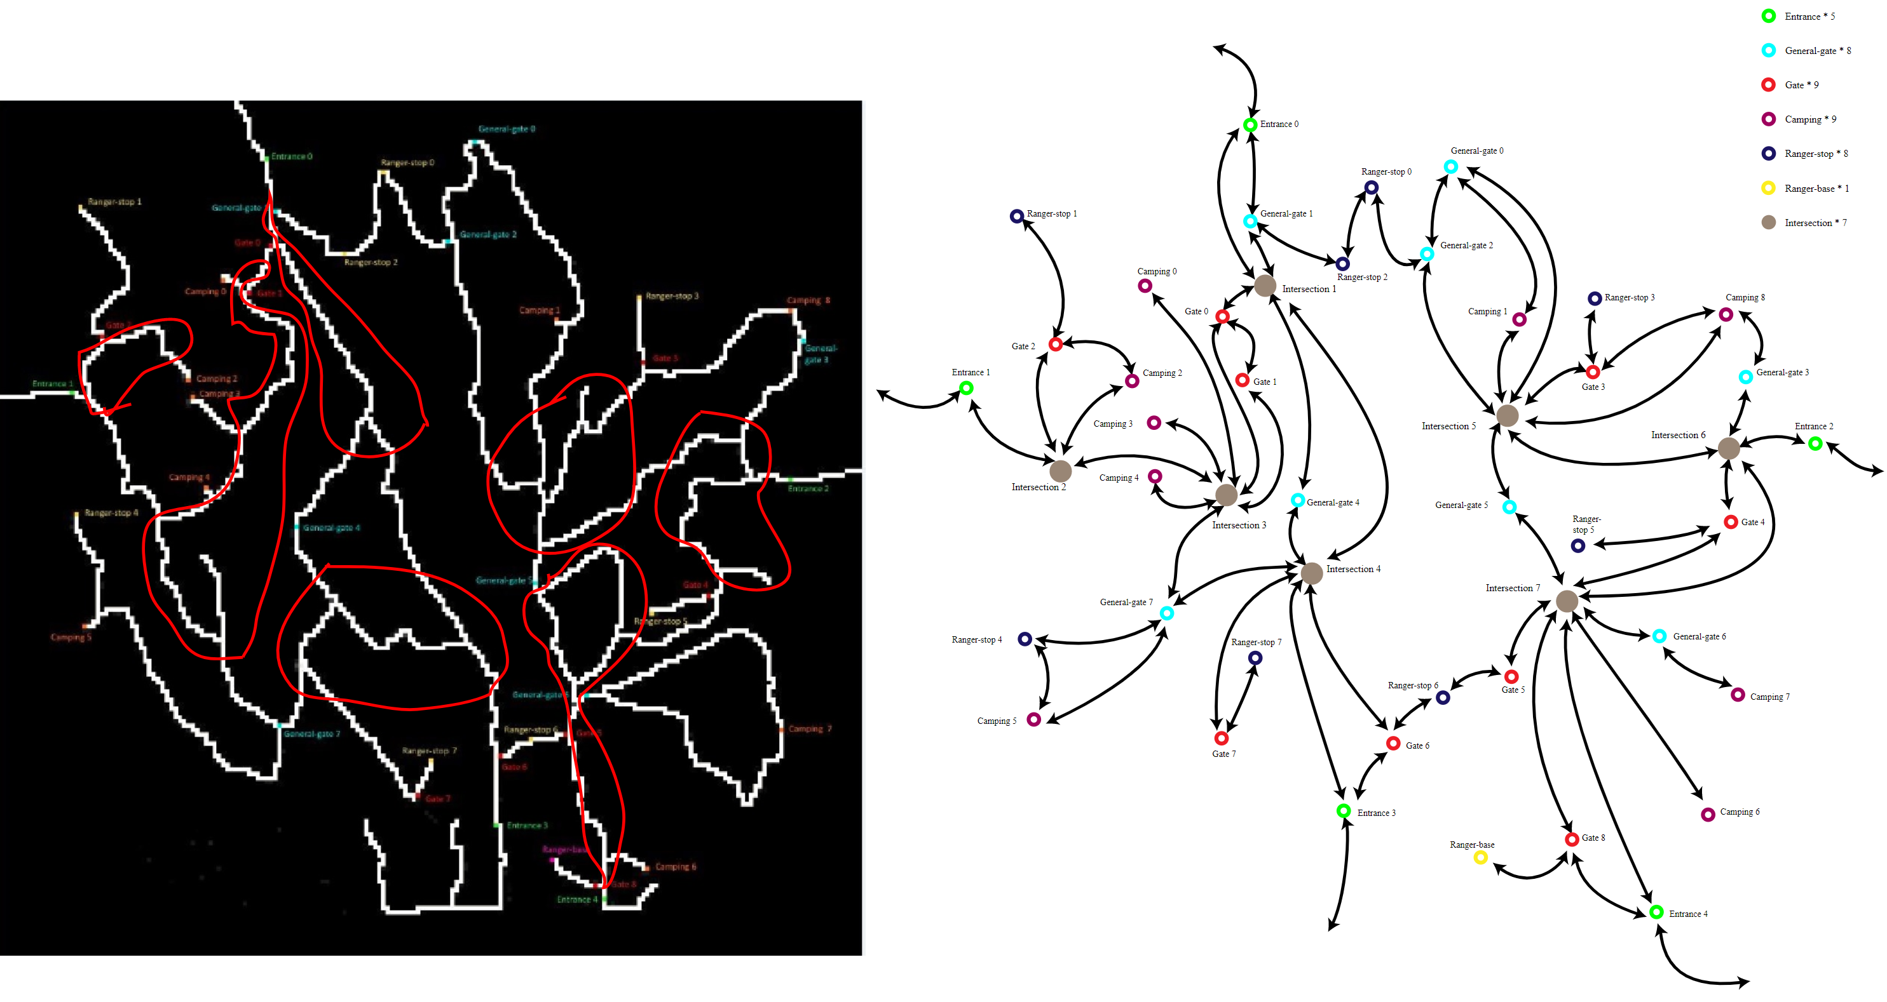
Data analysis and preprocessing
Map Analysis and Optimization
Notes:
We also analyzed and optimized the park map by eliminating the redundant information such as road curves/turns that really don’t matter to the sequential events. We also optimized the locations of the sites and gates for accommodating our design, where the abstracted map resembles the original one.

Slide 6
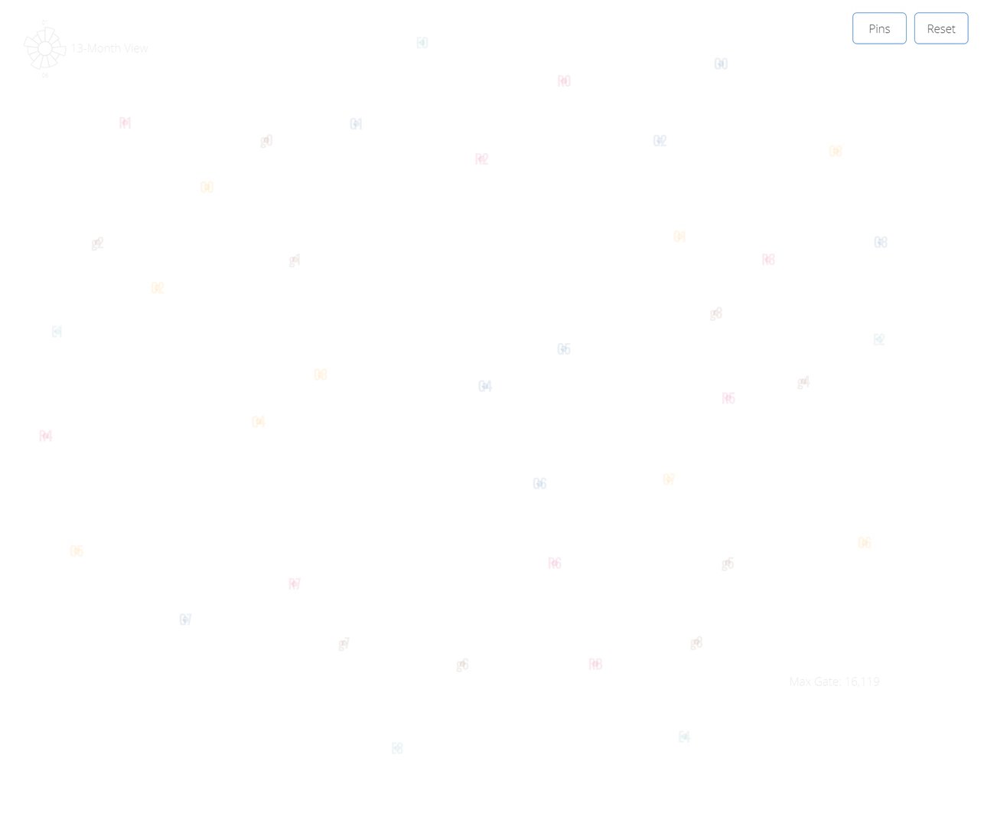
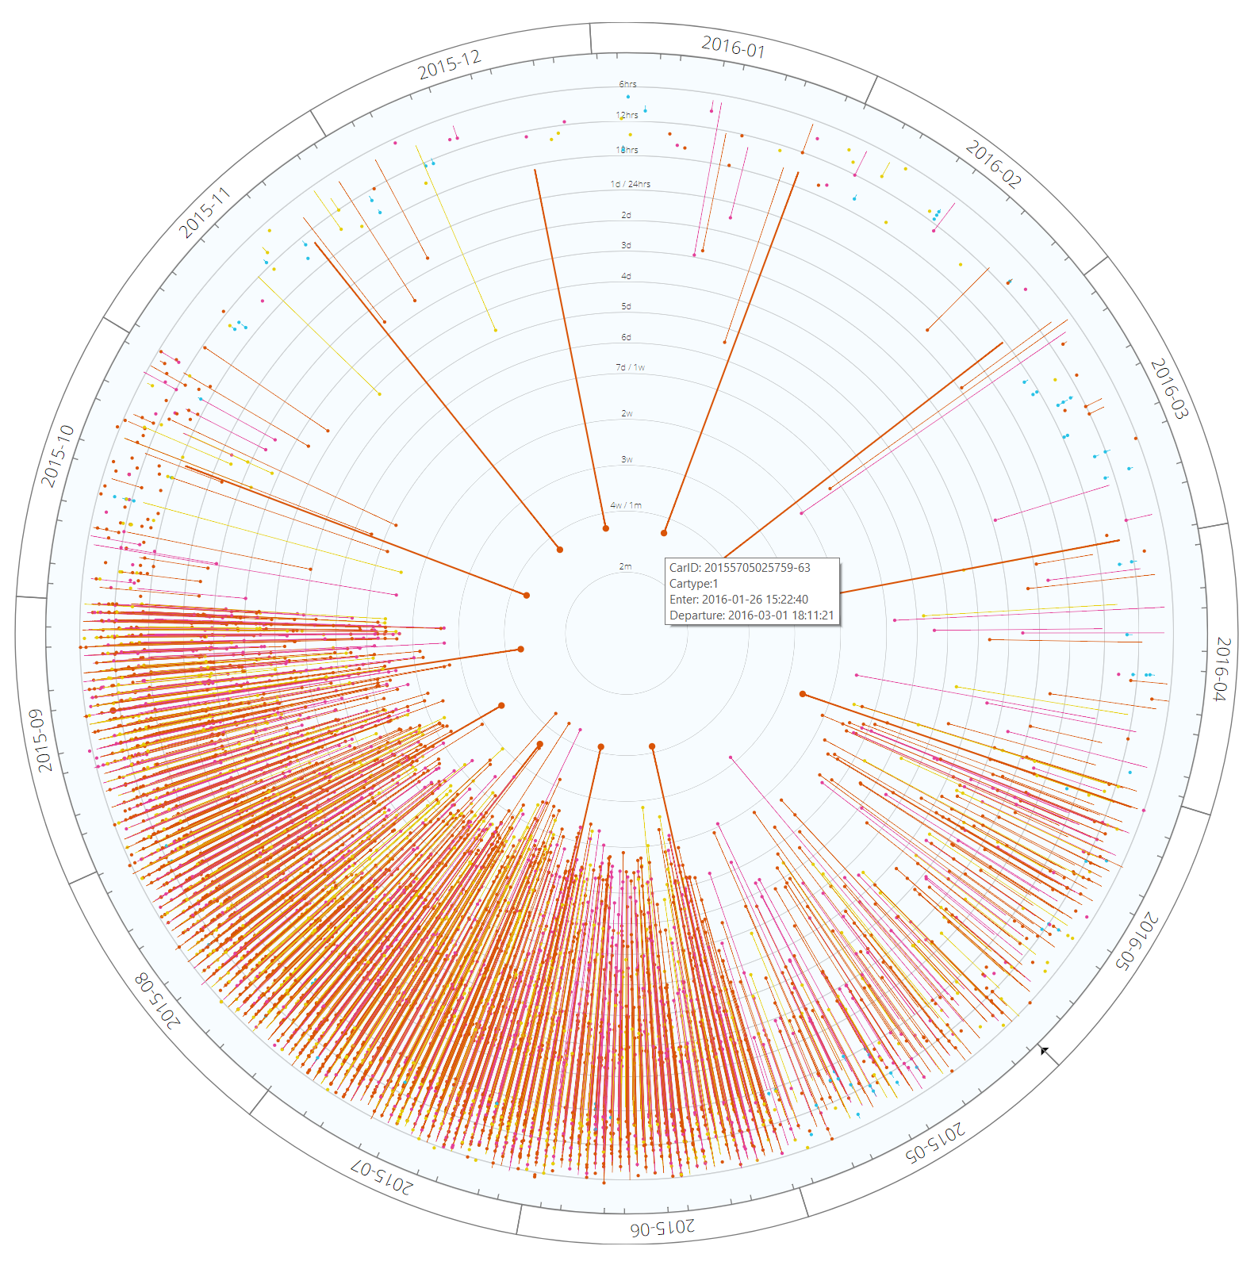
Our Solution - ClockPetals
To discern the sequential traffic and site-staying patterns
Map View – Sequential Pattern
Pin View – Site-staying pattern

Slide 7
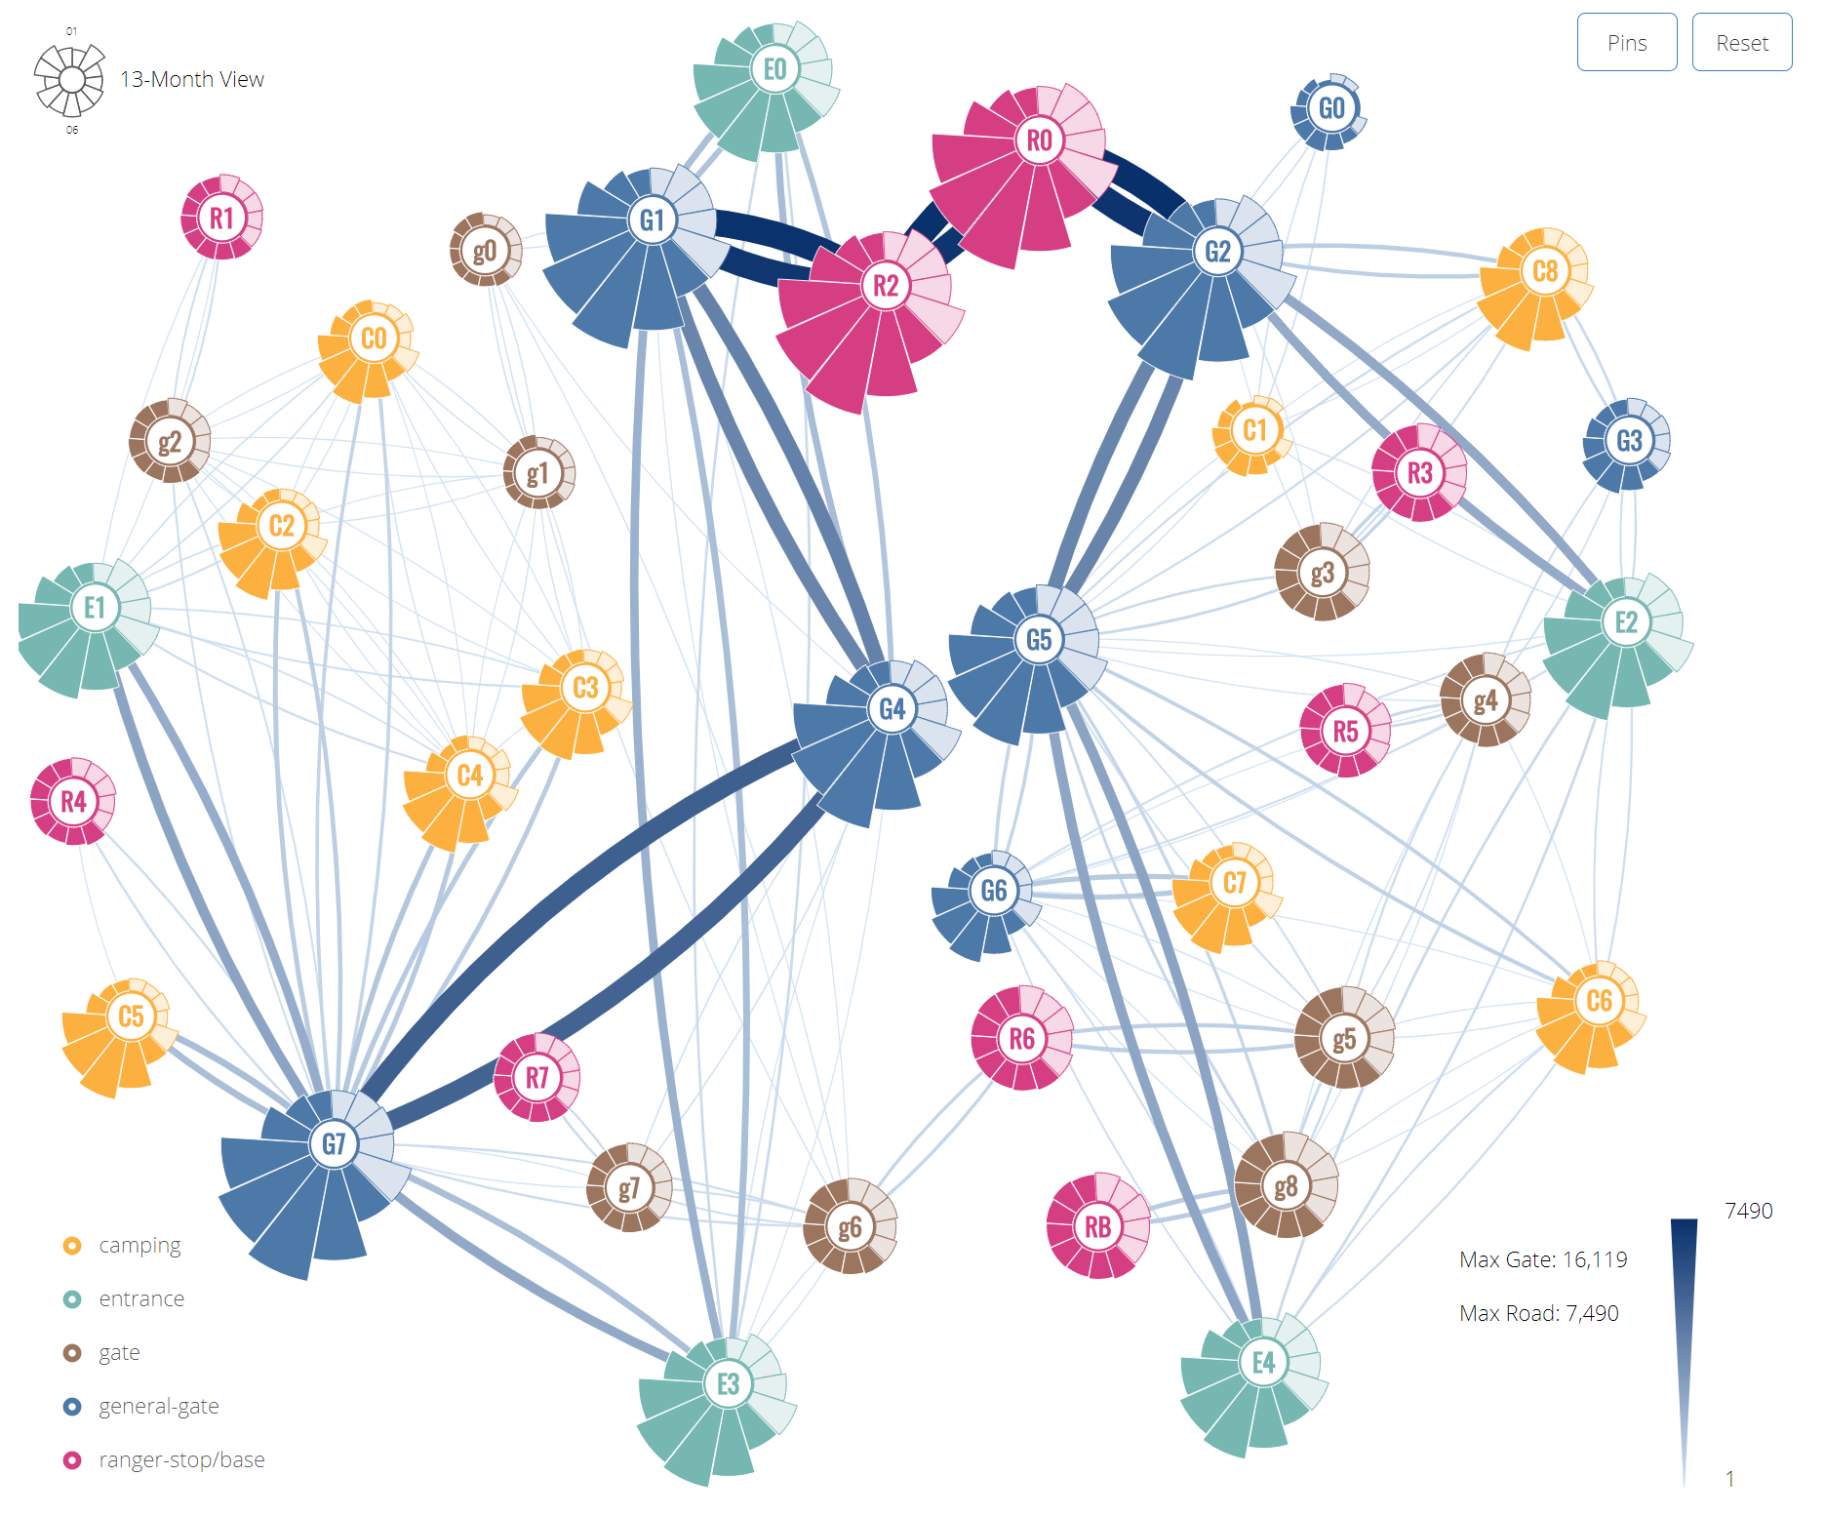
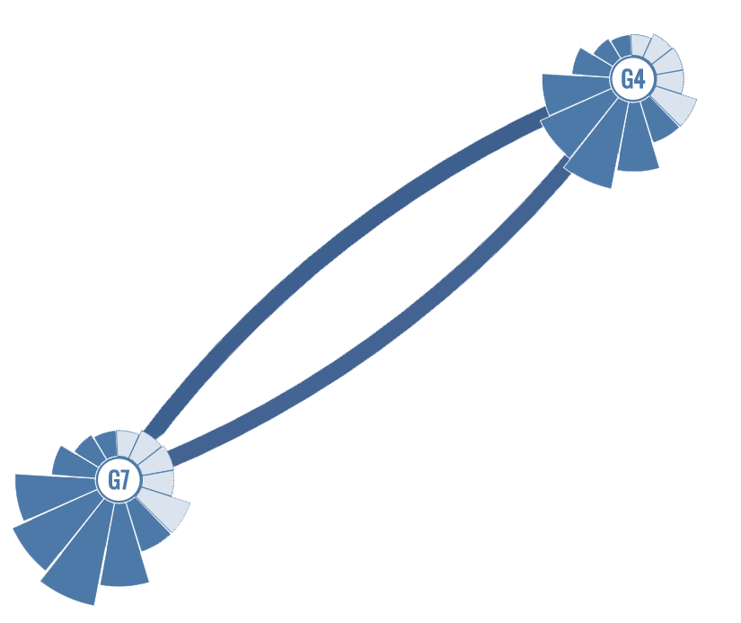
System Architecture
Map Abstraction with TWO-WAY traffic

Slide 8
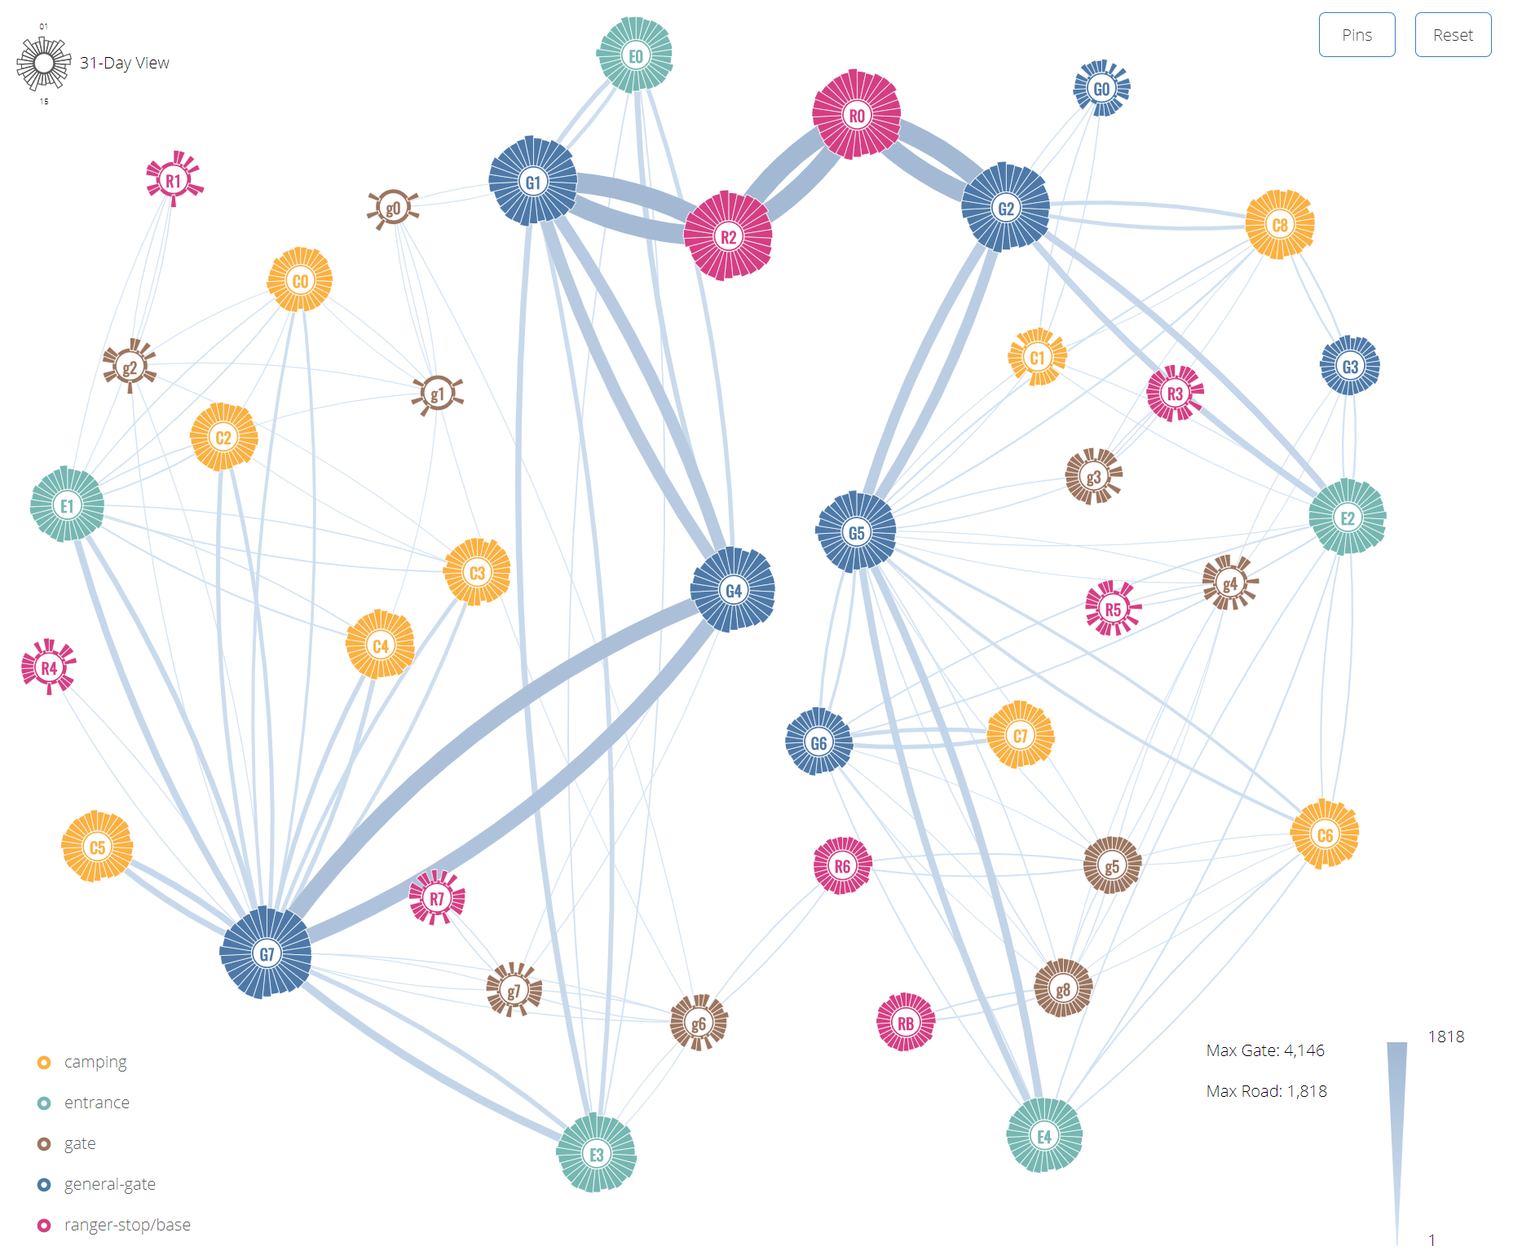
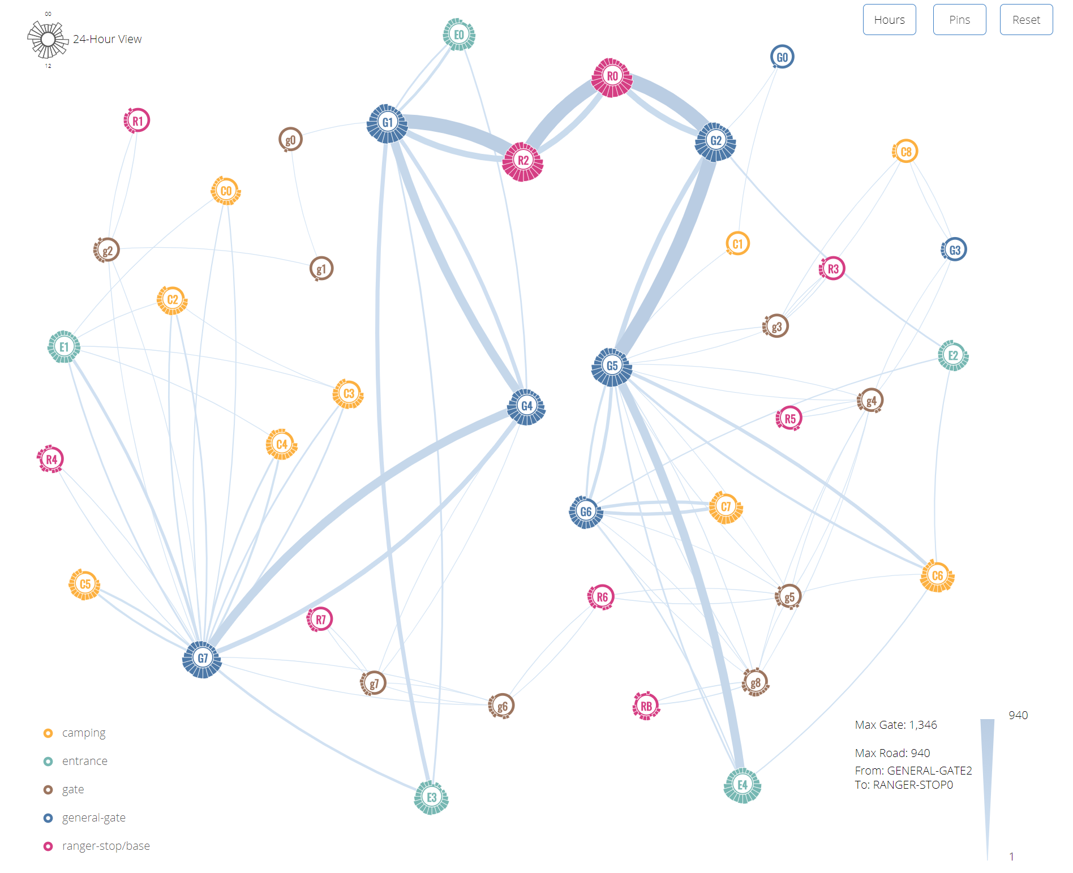



System Architecture
Flowers ( Nodes and Petals ) in route network
Five-color scheme for sites
Size of the flower’s center represents site traffic
Petals of 13 months aligns clockwise around the site node
Color represents site type
Opacity differentiate years
Area of a petal shows the traffic
Petals depict three time ranges in three temporal views for filtering.

Slide 9
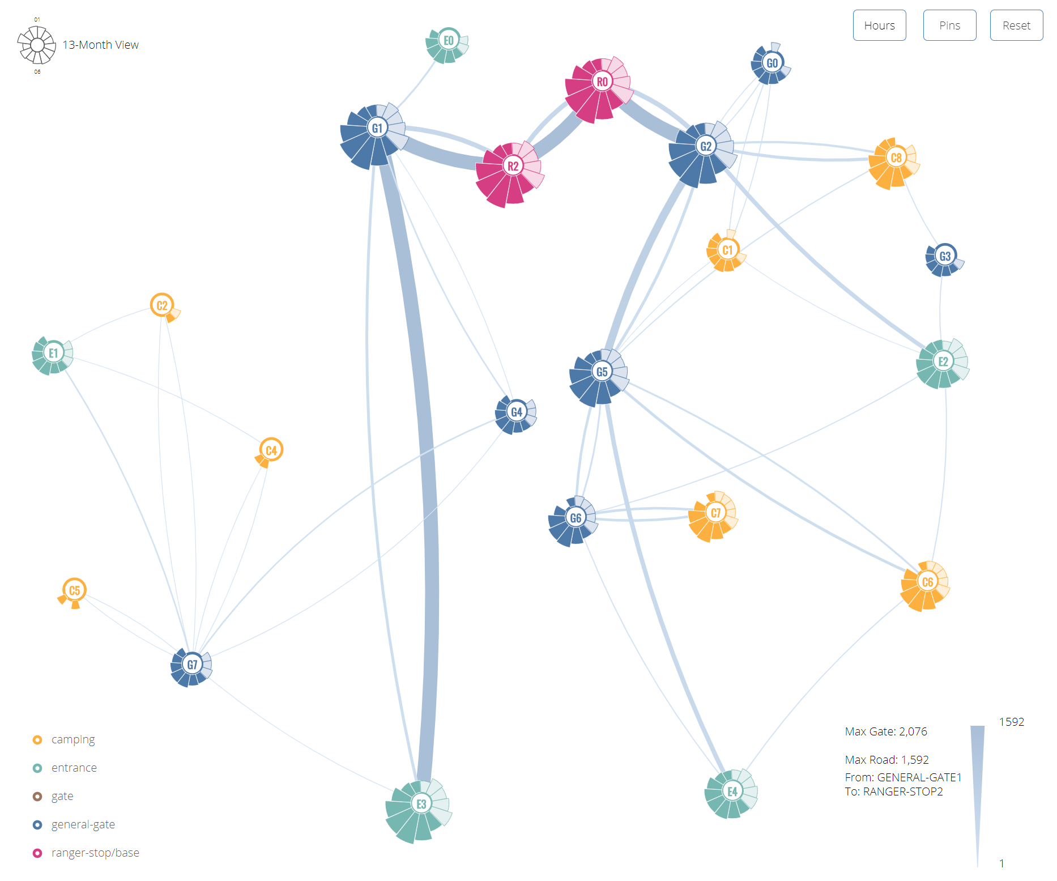
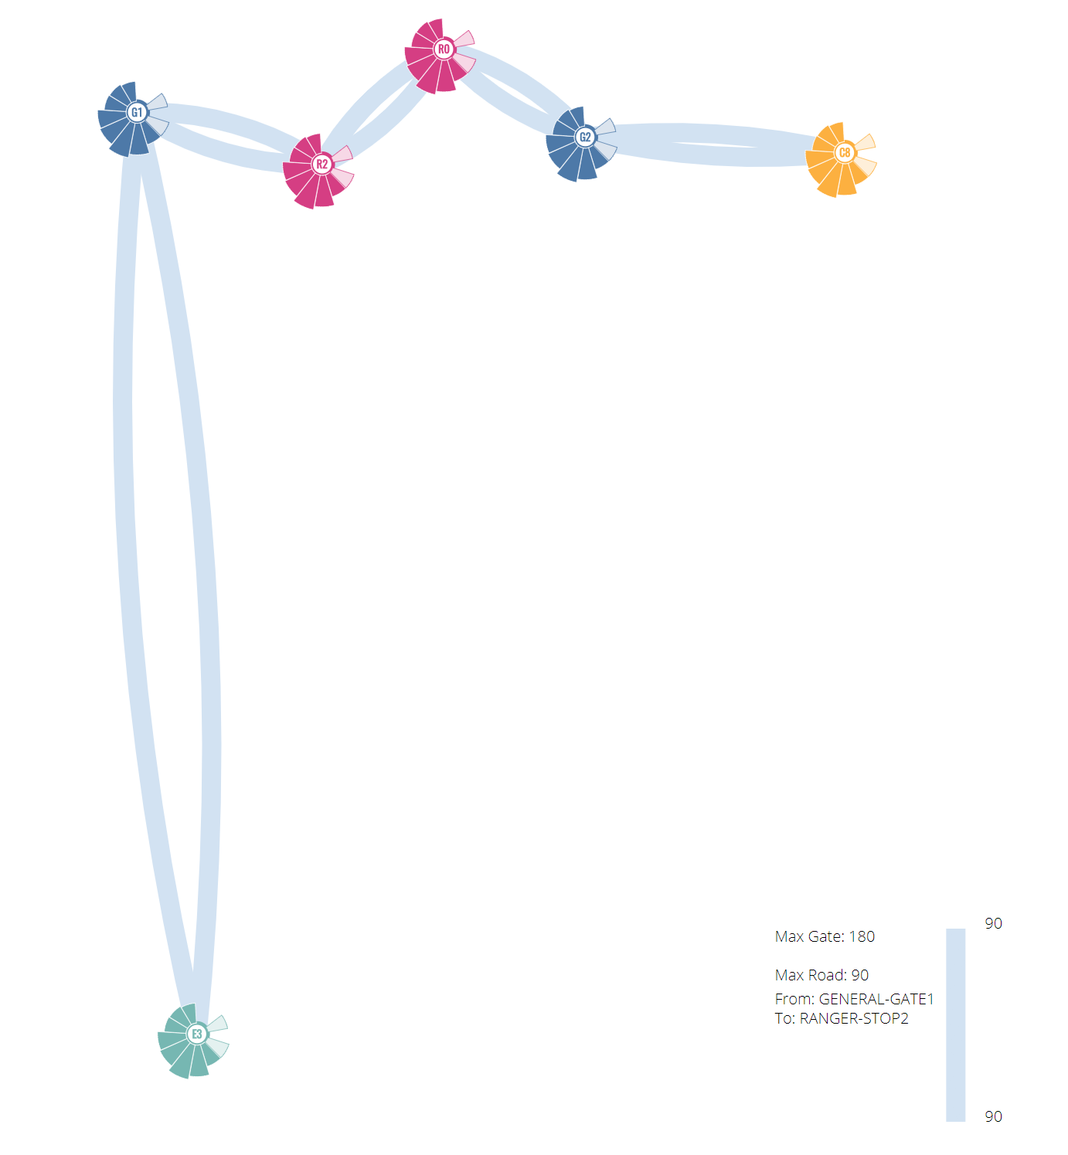
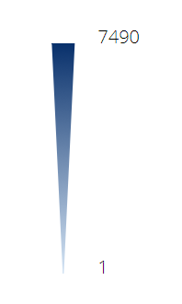
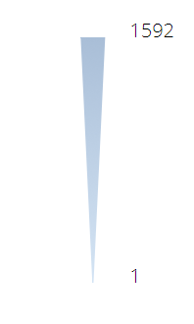
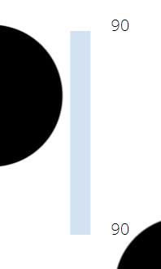
System Architecture
edges (vines) in route network
Vines are double coded by both color and width to represent the number of the vehicles traveled on the route segments.
Notes:
Color shows the absolute global scale and is interpolated based on the data value
Width shows the relative local scale and changes along with its color range
With fewer vehicles filtered, the vines color becomes lighter but the maximum width remained.

Slide 10
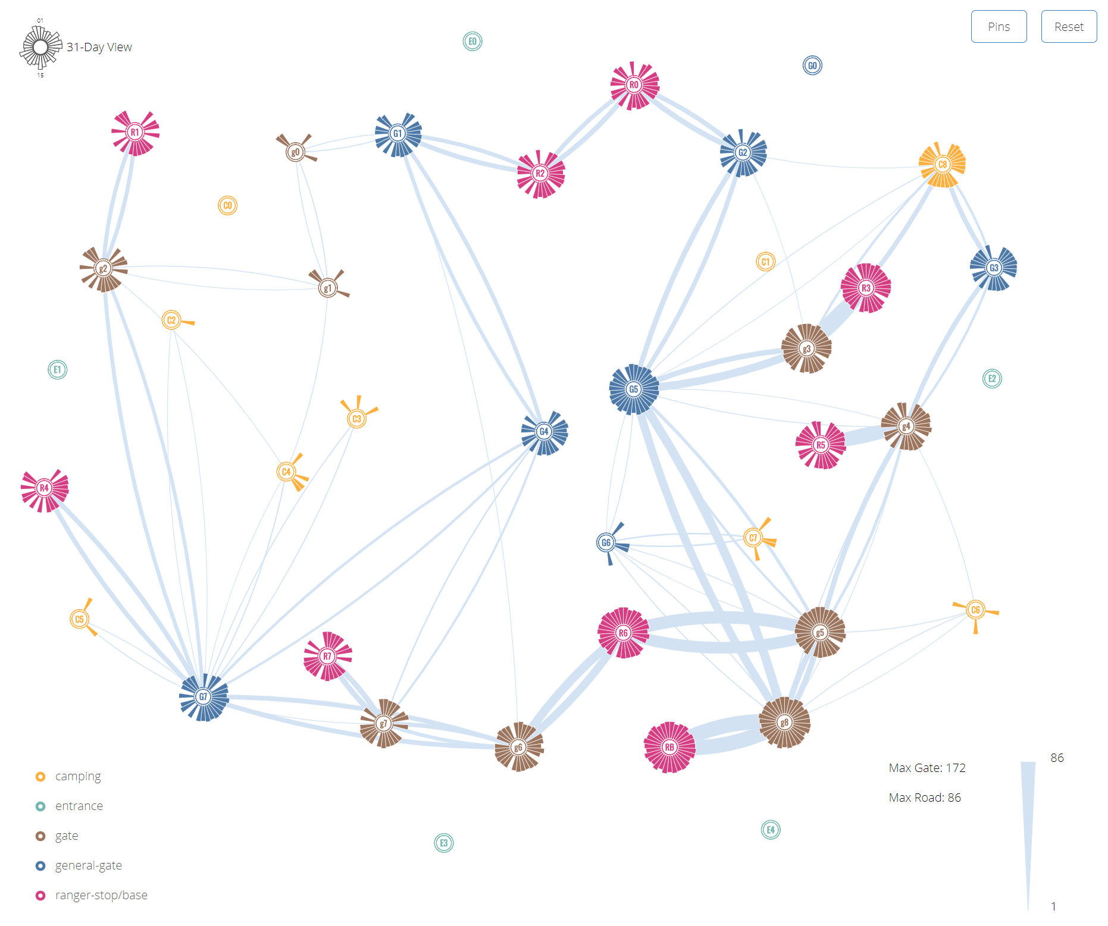
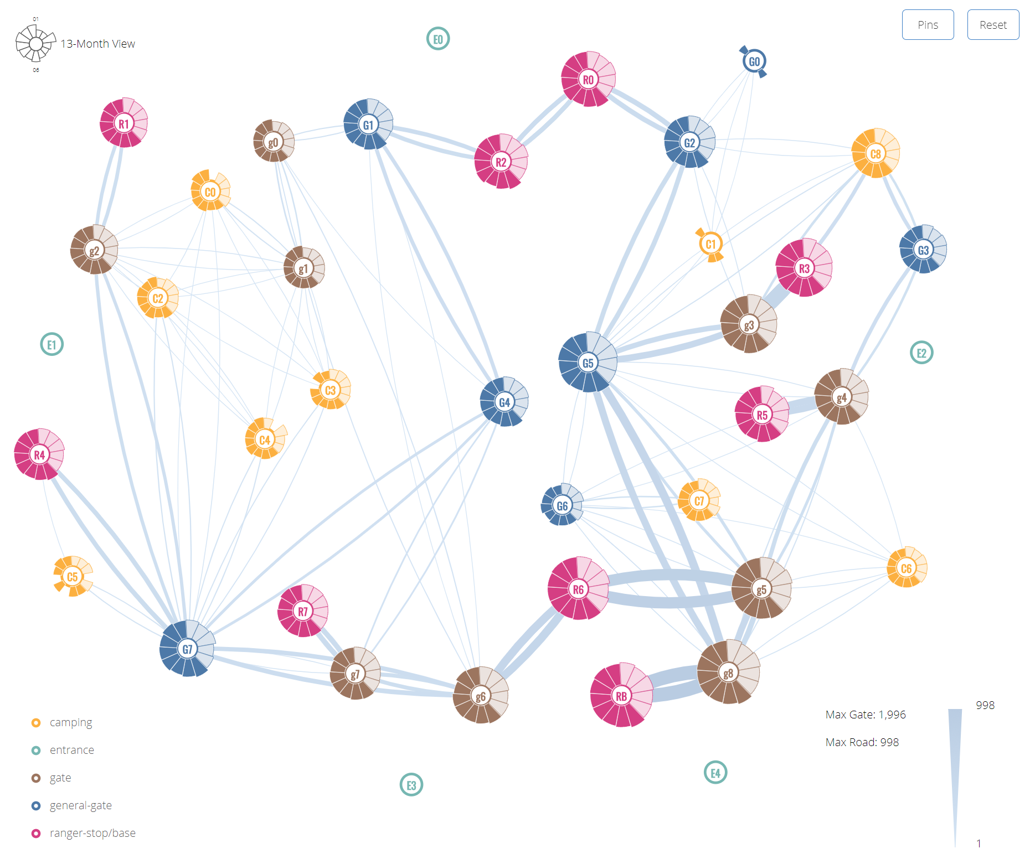
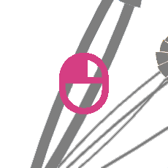

System Architecture
Multi-dimensional exploration with filtering
Route Filter
Vehicle Filter
Month Filter

Slide 11
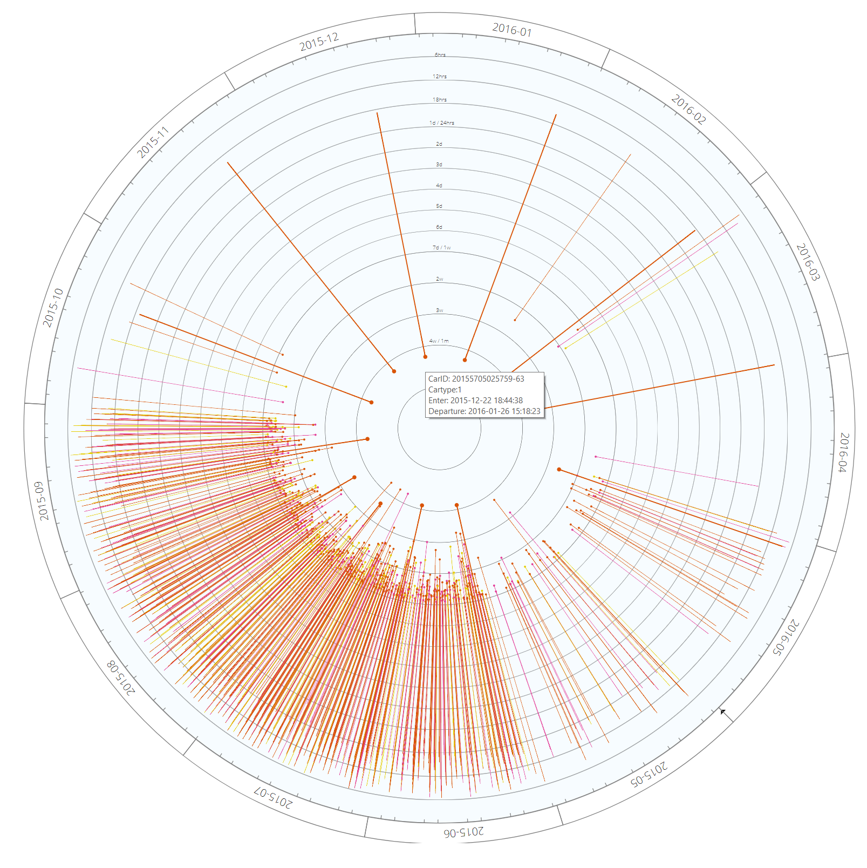

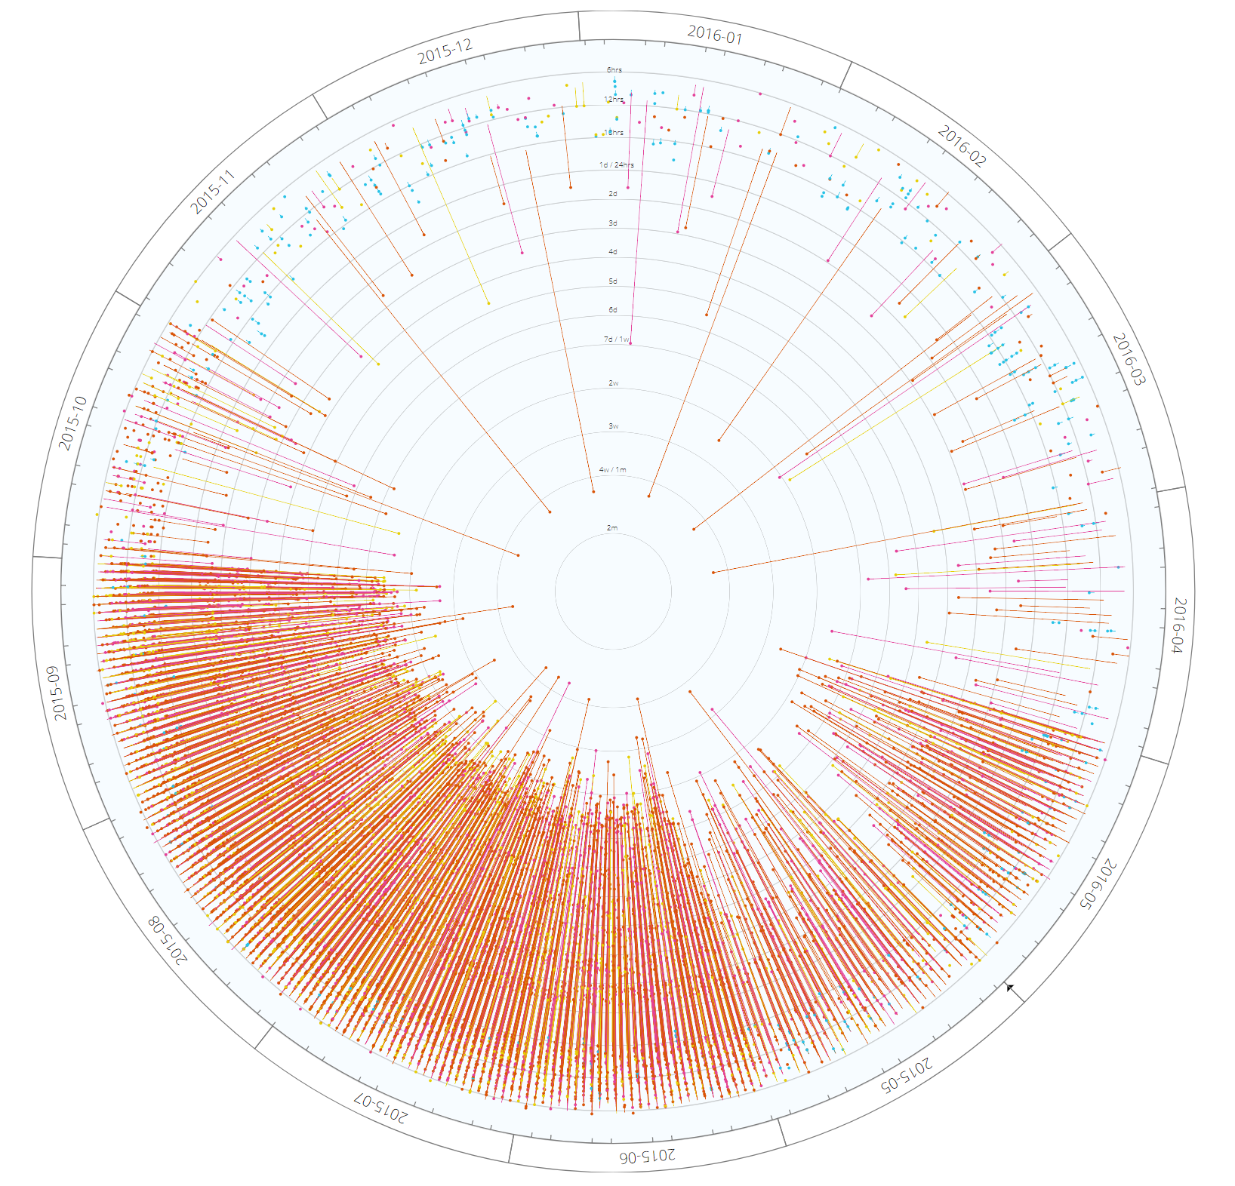
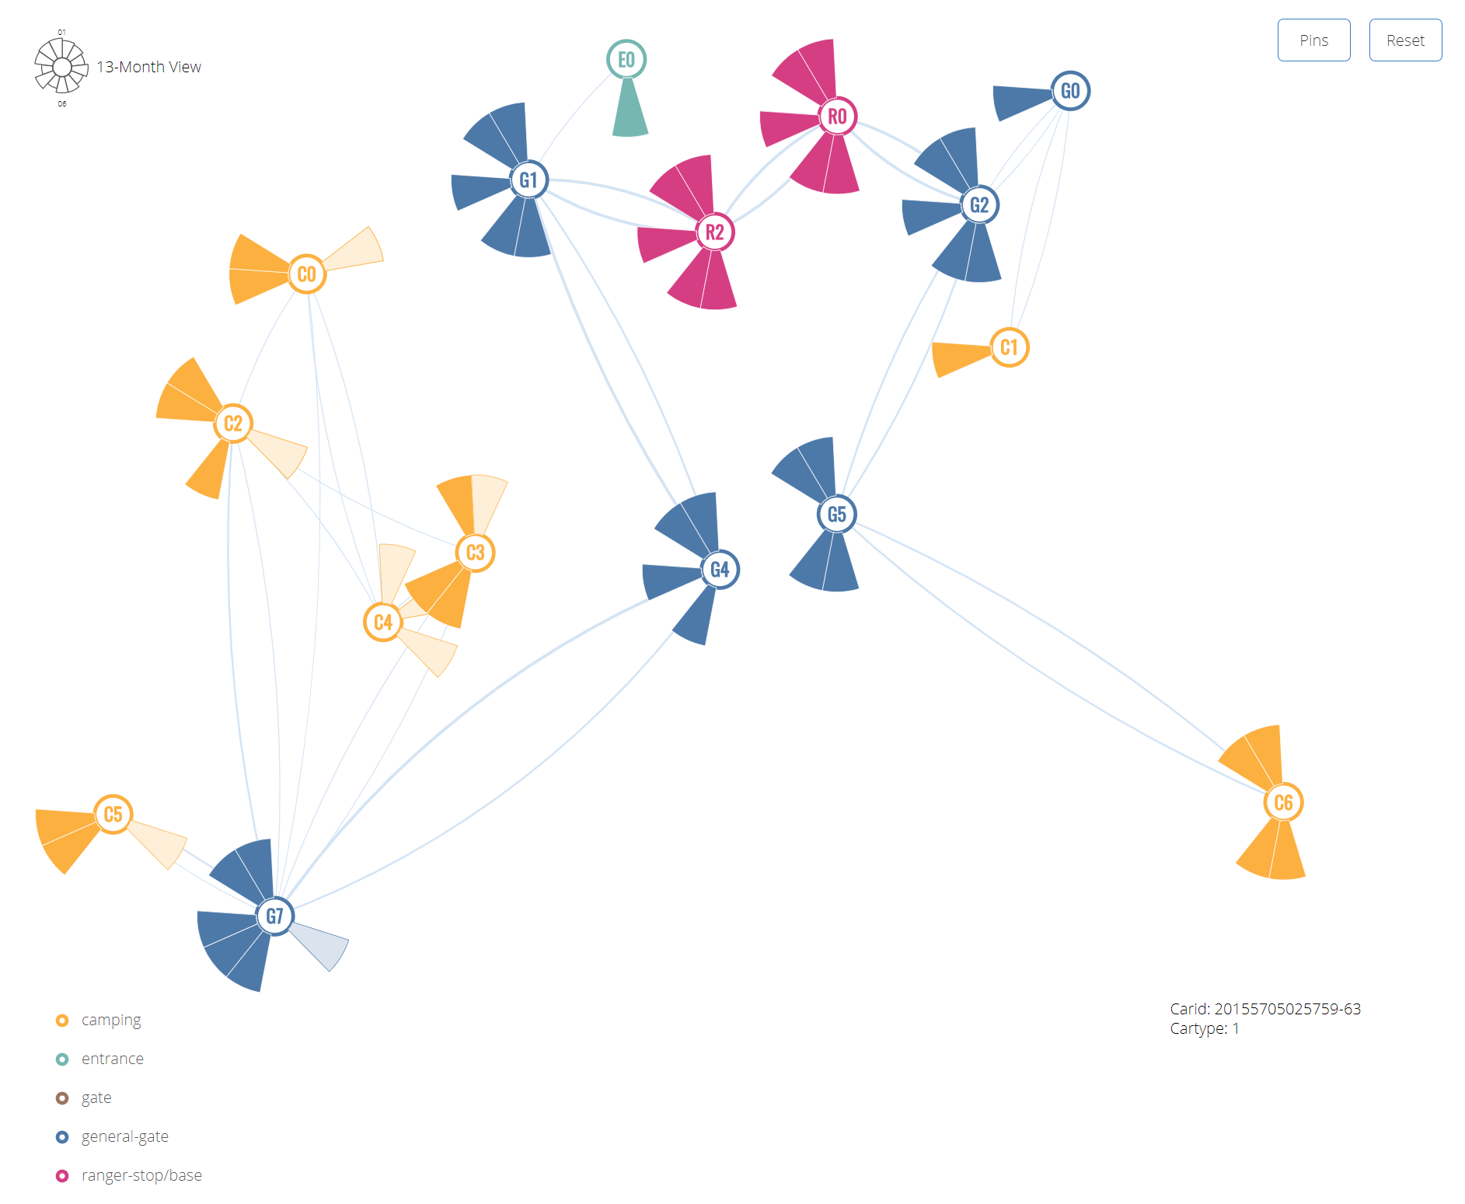
System Architecture
Detailed pin view of visits and map linkage

Slide 12
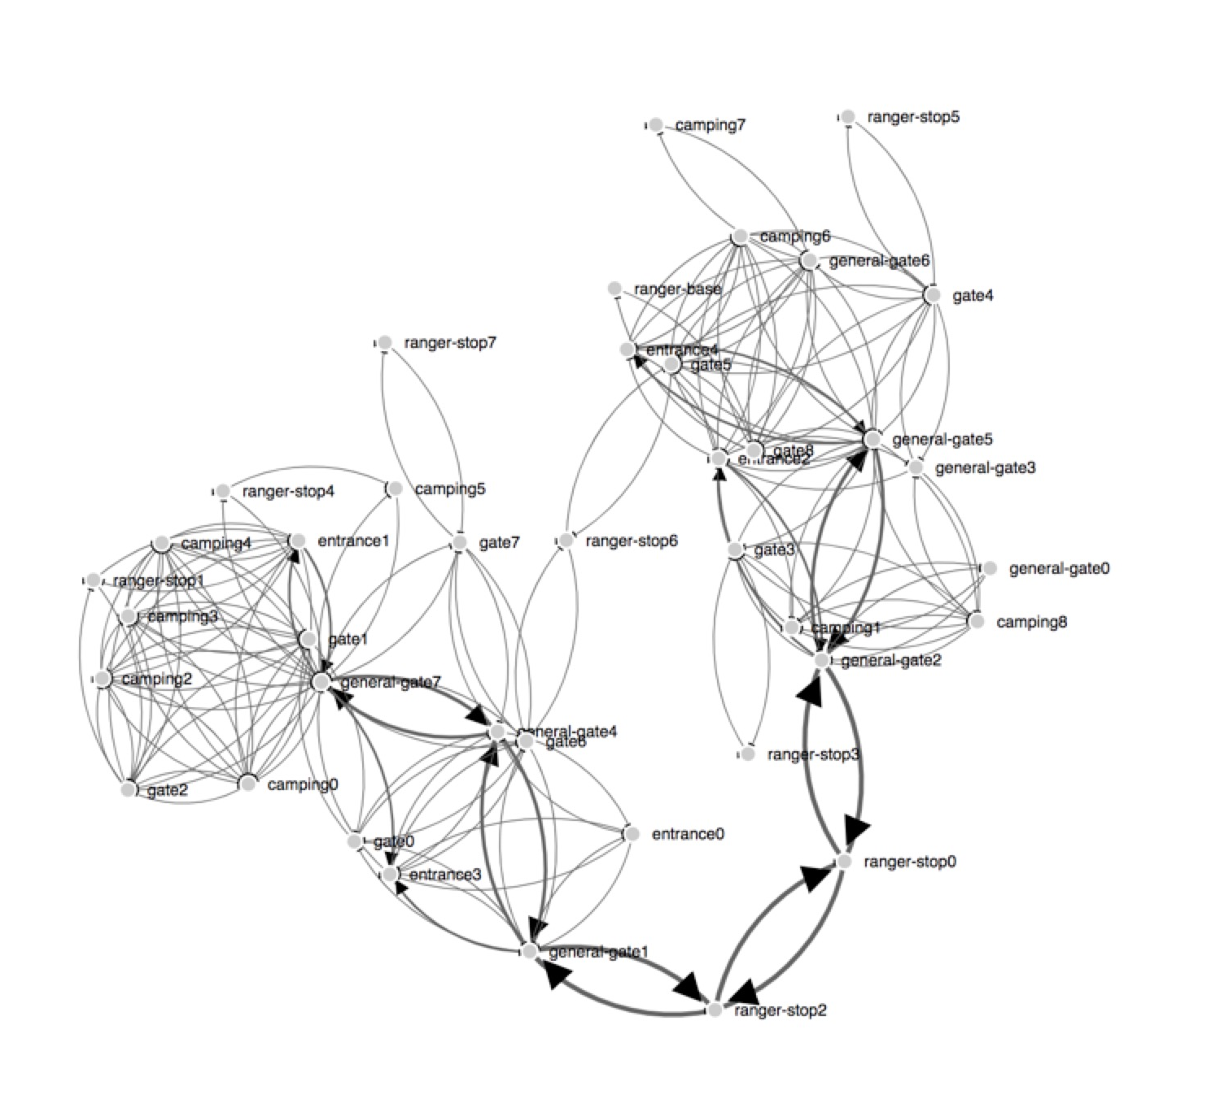
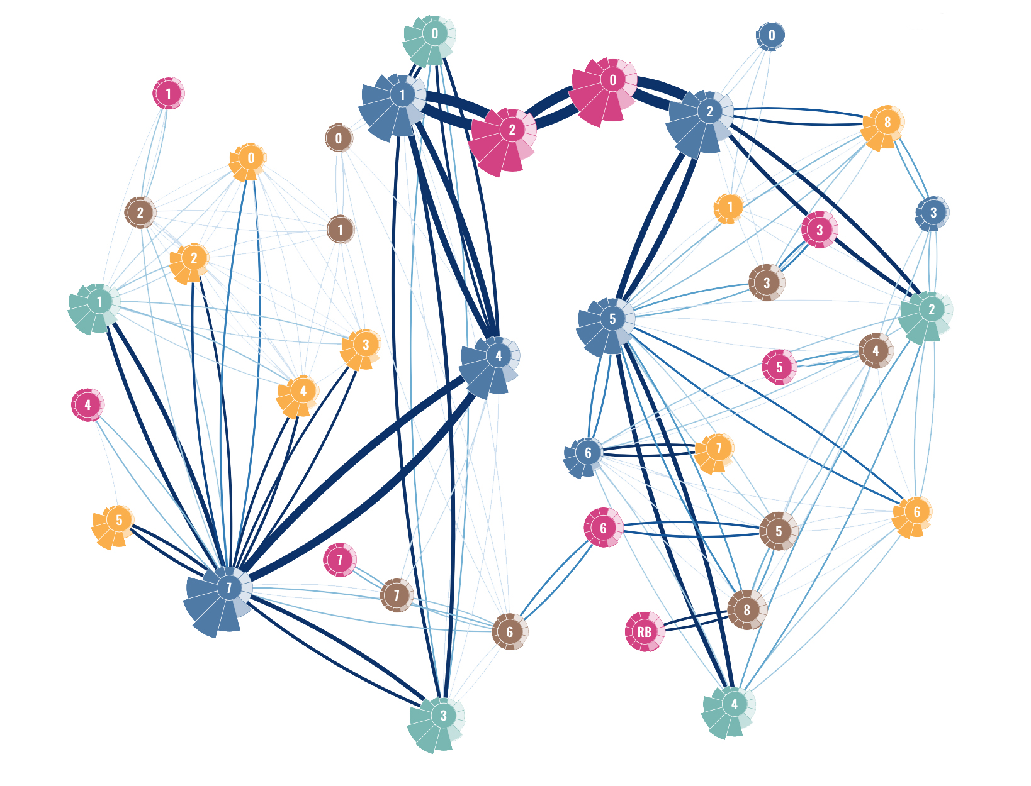
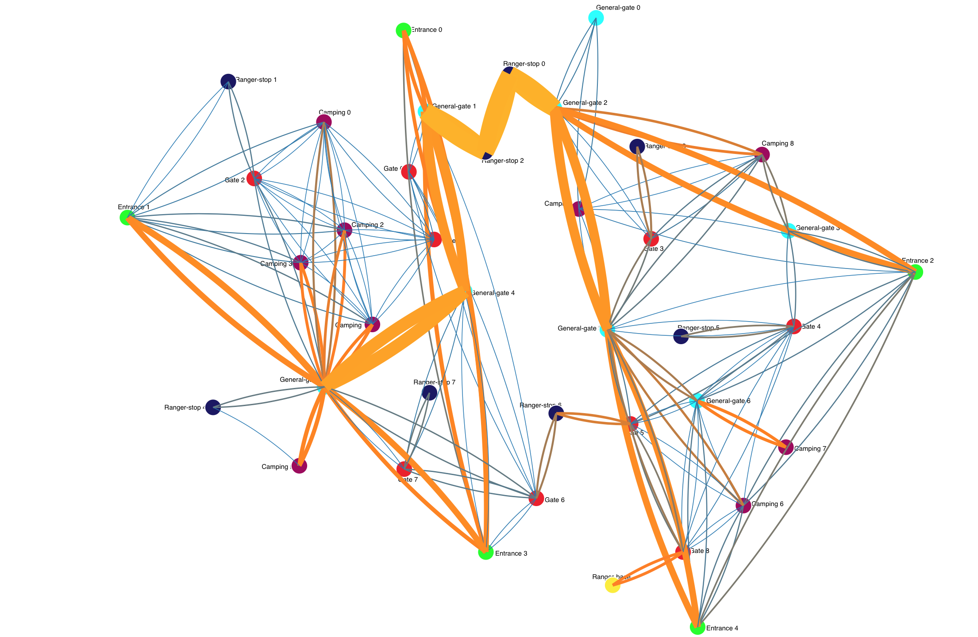
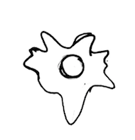

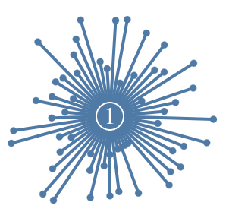


DESIGN
Overall process
Map
Node
Notes:
I will introduce the design process and consideration of our mini challenge one.
We used a agile process, quickly generate ideas, implement the ideas immediately, find problems, and then improve the design.
I will separate our design into three section to introduce.
First is our map
Second is the node, which is the gates, on the map
And finally the camping site.

Slide 13
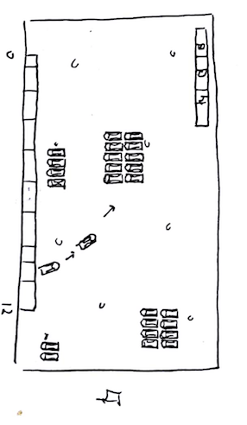
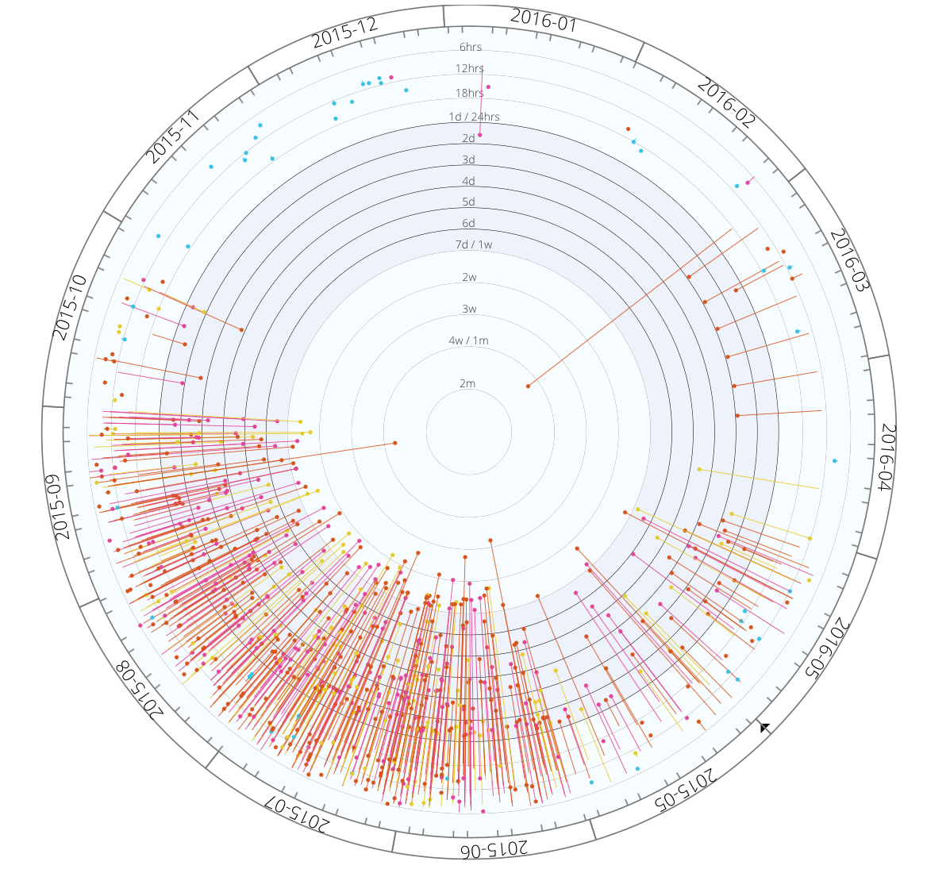
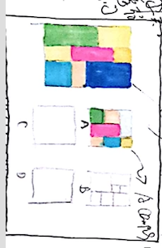
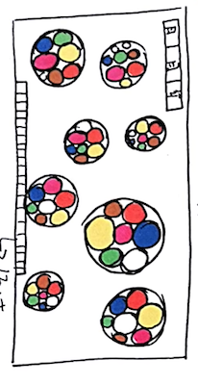
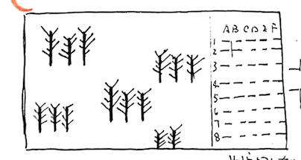
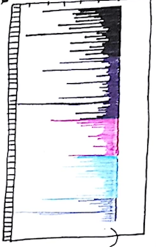
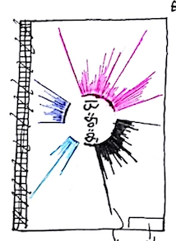
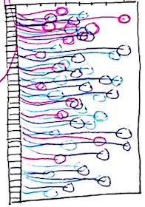
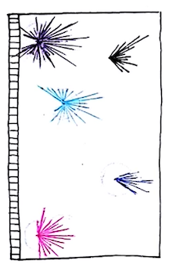
DESIGN
Overall process
Camping Site
Notes:
(Jump)

Slide 14
Design
MAP
Directed Network Graph
The shades of links means traffic amounts
Arrows means directions
Problems: nodes and links overlap
Notes:
Firstly, map
The first idea came into our mind is the network map of the 40 gates.
The shades of links means the traffic amounts of this link.
And the arrow means direction.
The problem of this graph is obvious
The nodes and links are overlapping, we cannot see the patterns clearly.

Slide 15
Design
MAP
Geographic-based Network
The positions of nodes are abstracted from the real map
Different color of nodes means different kinds of gates
Links are double encoded: color + width
Problems:
  two colors are confusing
  Link widths are hard to differentiate.
Notes:
The next step, we locate the gates according to the real map
And we use different colors for different kinds of gates.
For the link, we used double encoding. The color and the width of link.
Color from deep blue to light orange, along with width from thin to thick.
The problem of this map is that the two colors are confusing,
And the link widths are hard to compare when they are relatively small.

Slide 16
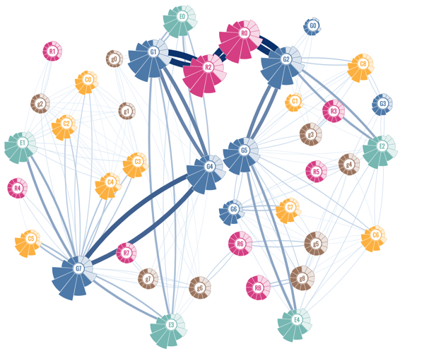
Design
MAP
Final Design
Positions of gates are properly distributed
Colors of the gates are carefully designed
Only use one color for links
Use shades + width to represent traffic amounts
Link width changes dynamically
Notes:
Based on the problem we had in the previous design, we carefully improved all the elements
Firstly, the position of gates are properly adjusted to reduce the overlapping. But it still keeps the relative position they have in the map
Secondly, the color are carefully selected, so as to differentiate different kinds of gates and links. As we know that different kinds of gates have different characteristics.
Also, we only use one color for the links to reduce visual complexity. But it’s still double encoding – shades and width
What’s more the link width changes dynamically as introduced by Zheng, by that we can compare different links visually when their value is small or close.
The color of links won’t change, so we can still tell the range of the amount of traffic.

Slide 17
Design
Node
Notes:
The second section of our design is the node, or gates.
We decided to show information for gates on the nodes from the very beginning, which can help us to see more patterns in a single graph
The information for the gates is the amount of traffic pass through it. It has year patterns, month patterns and day patterns.
We had many solutions. Such as lines, areas, flowers with water drop shape, dandelion, radial bar chart, and radial fan chart.
We tested them on the map. As we can see, some of them have visual conflicts with the links.

Slide 18
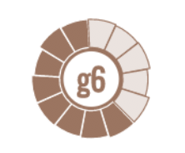
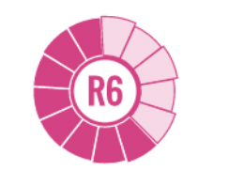


Design
Node
Gate
Camping
General Gate
Ranger stop/base
Entrance
Color: Different and in harmony; also in harmony with links.
Shape: fan instead of line
Name: Color + letter to identify different kinds of gates
Time: two year, 13 months
Notes:
We really liked the idea of dandelion. But we had a huge problem of how to set the length of the petals.
As we had like 10 and 2000 for different month of a gate. It’s not visually balanced.
So finally, we chose to use fan, and the area shows the value
Also we use color plus the initial letter to show the kinds of gate. As only color are not easy to remember and identify the kinds

Slide 19
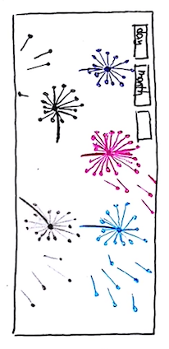
Design
Camping Site
Notes:
Last is our design for camping site
We aims to show how many people stays in the camping site, when they enter and when they leave
At first, we wanted to use some metaphor such as cars and woods.
But they were to general to describe the data, so we jumped to show detailed data.
We designed some formats of lines to show each vehicle's entering and leaving time.

Slide 20
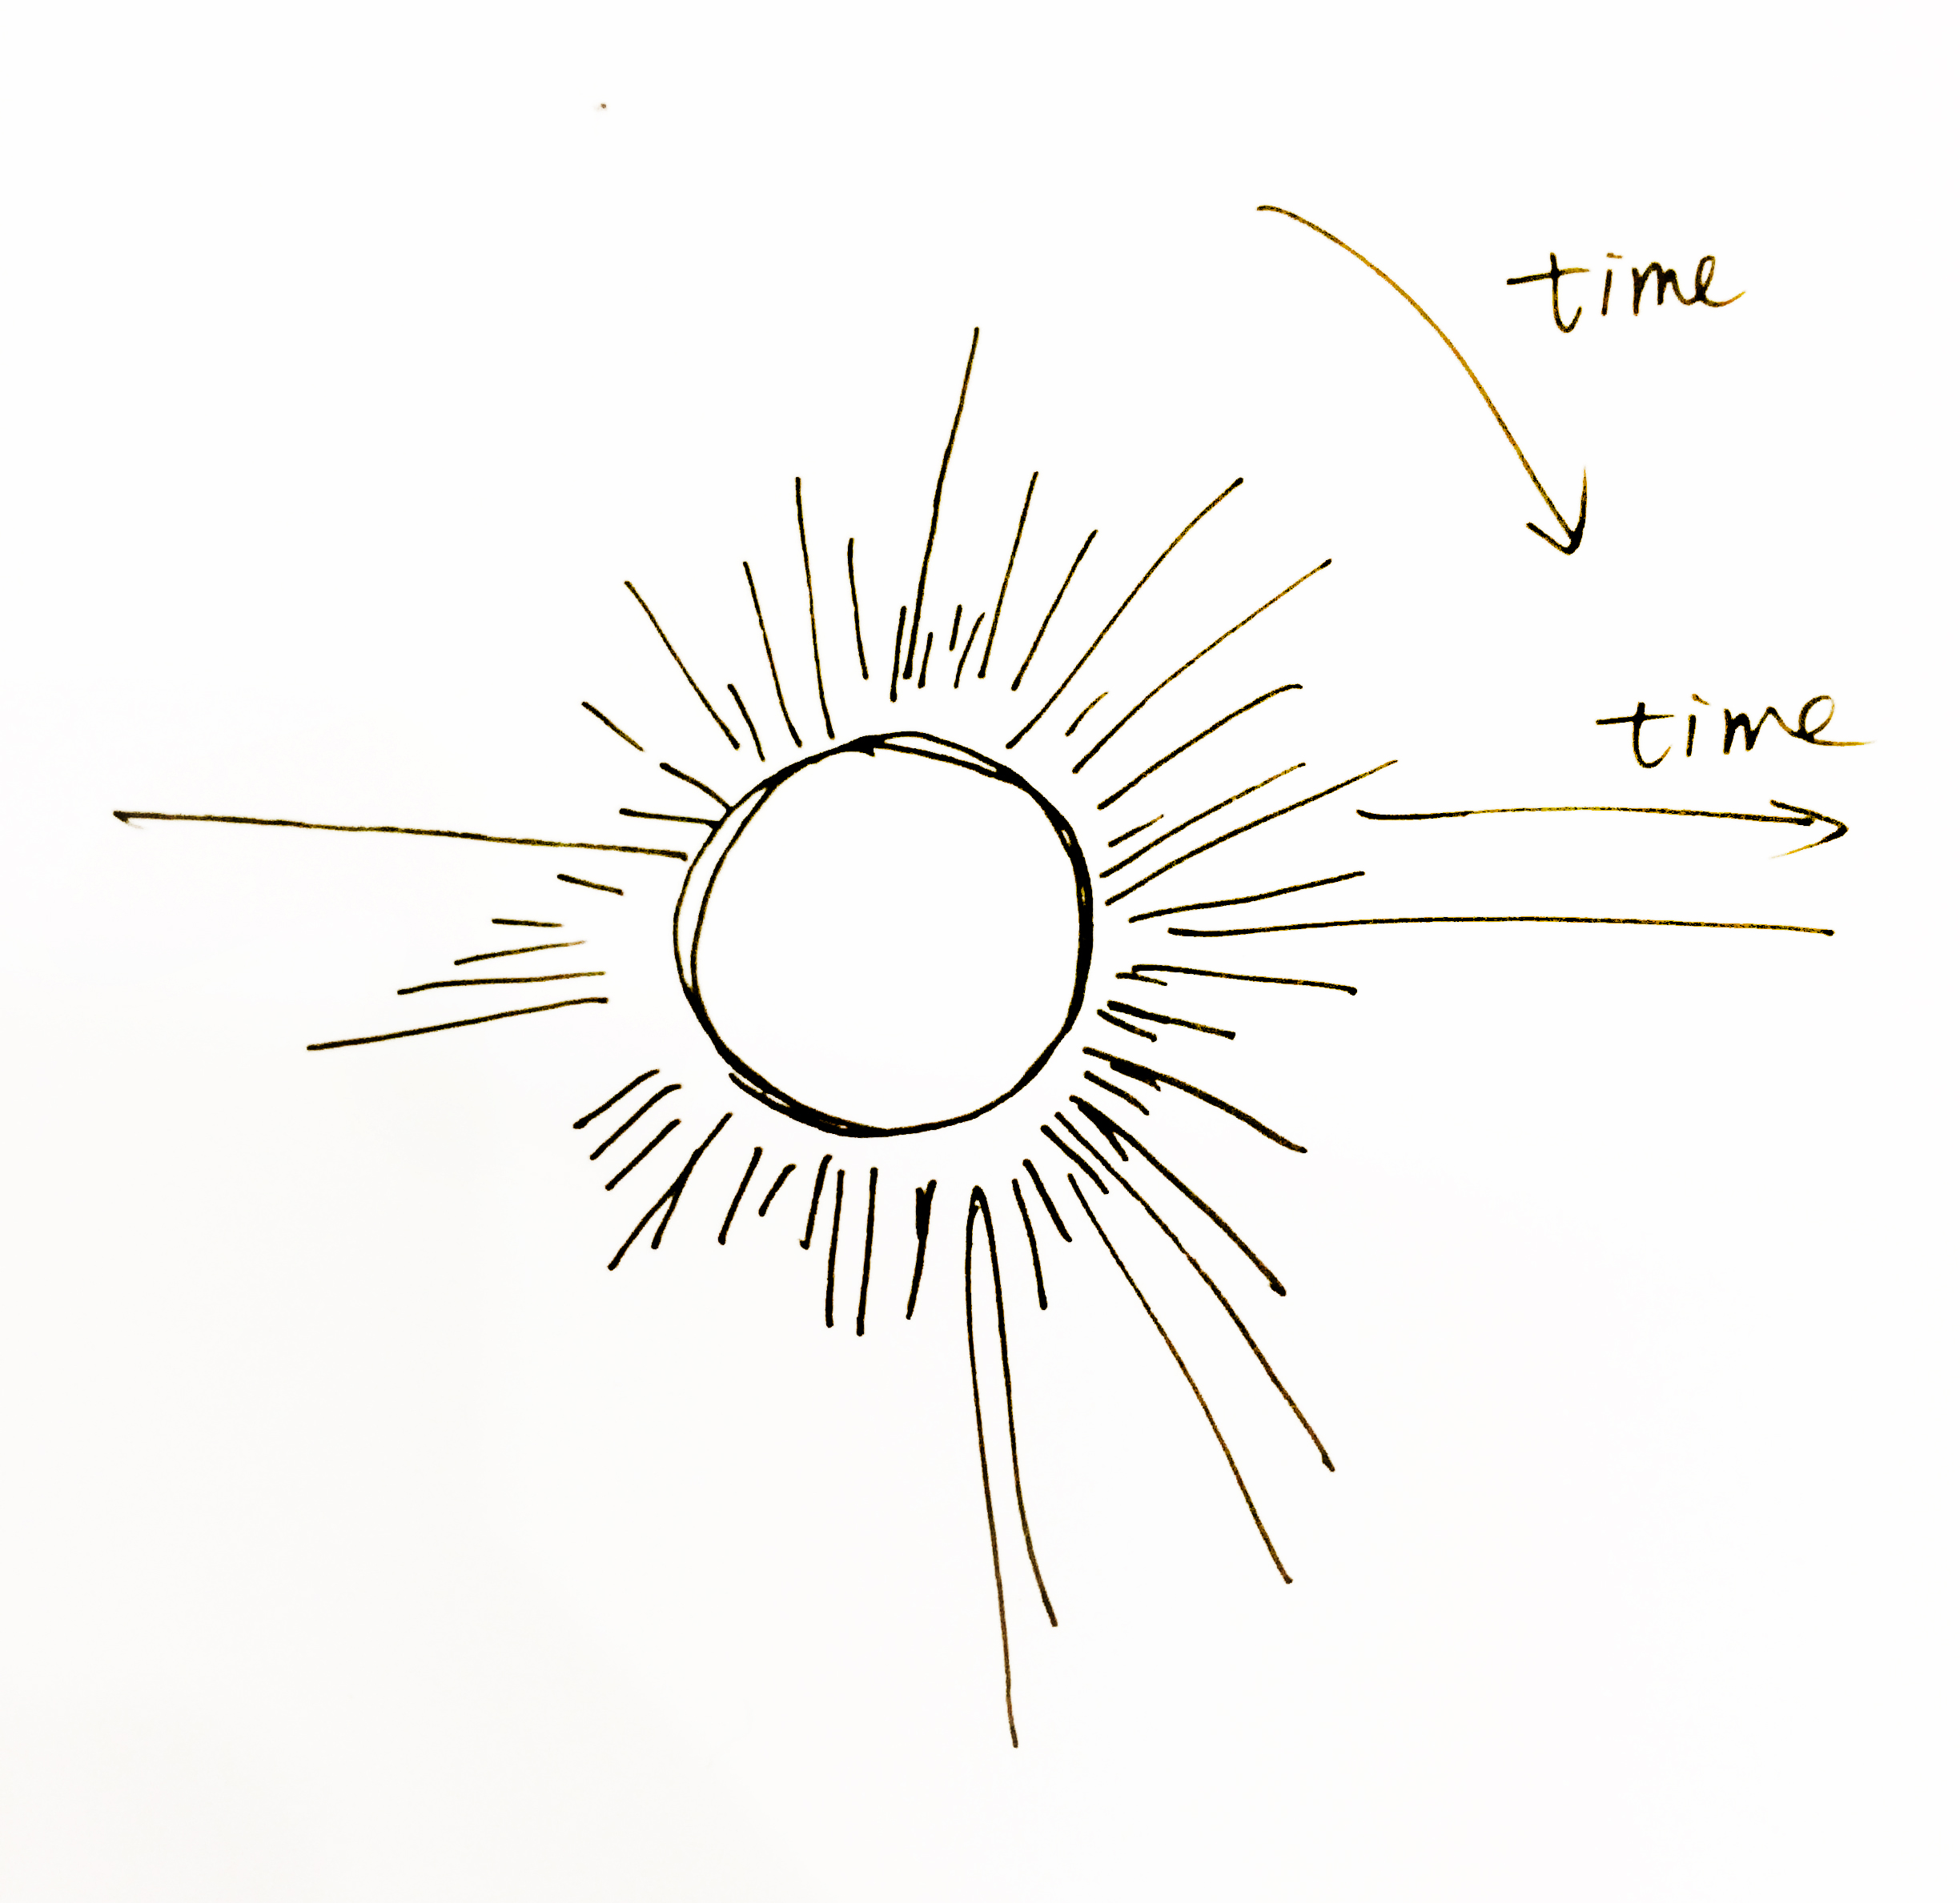
Design
Camping Site
Notes:
We really liked the design of this curtain line
But the problem is that it will be too long horizontally
Therefore we decide to use radial lines.
At first we design the lines explosive, but the start time is too intensive and hart to see the details and patterns
So finally, to chose to make the lines implosive. So that we can see the short visit clealy.

Slide 21
END of MC1
Map View – Sequential Pattern
Pin View – Site-staying pattern

Slide 22
WindNebula
Vectorial-Temporal Analysis for Environmental Assessment in Mini-Challenge 2

Slide 23
Dataset analysis
Vector based spatiotemporal problem
Vectors
Wind speed
Wind direction
×
Vectors
Factories’ location
Sensors’ location
(Distance, Direction)
×
Time
Daytime/Nighttime
Weekday/Weekend
Concentration
Chemical readings
×

Slide 24
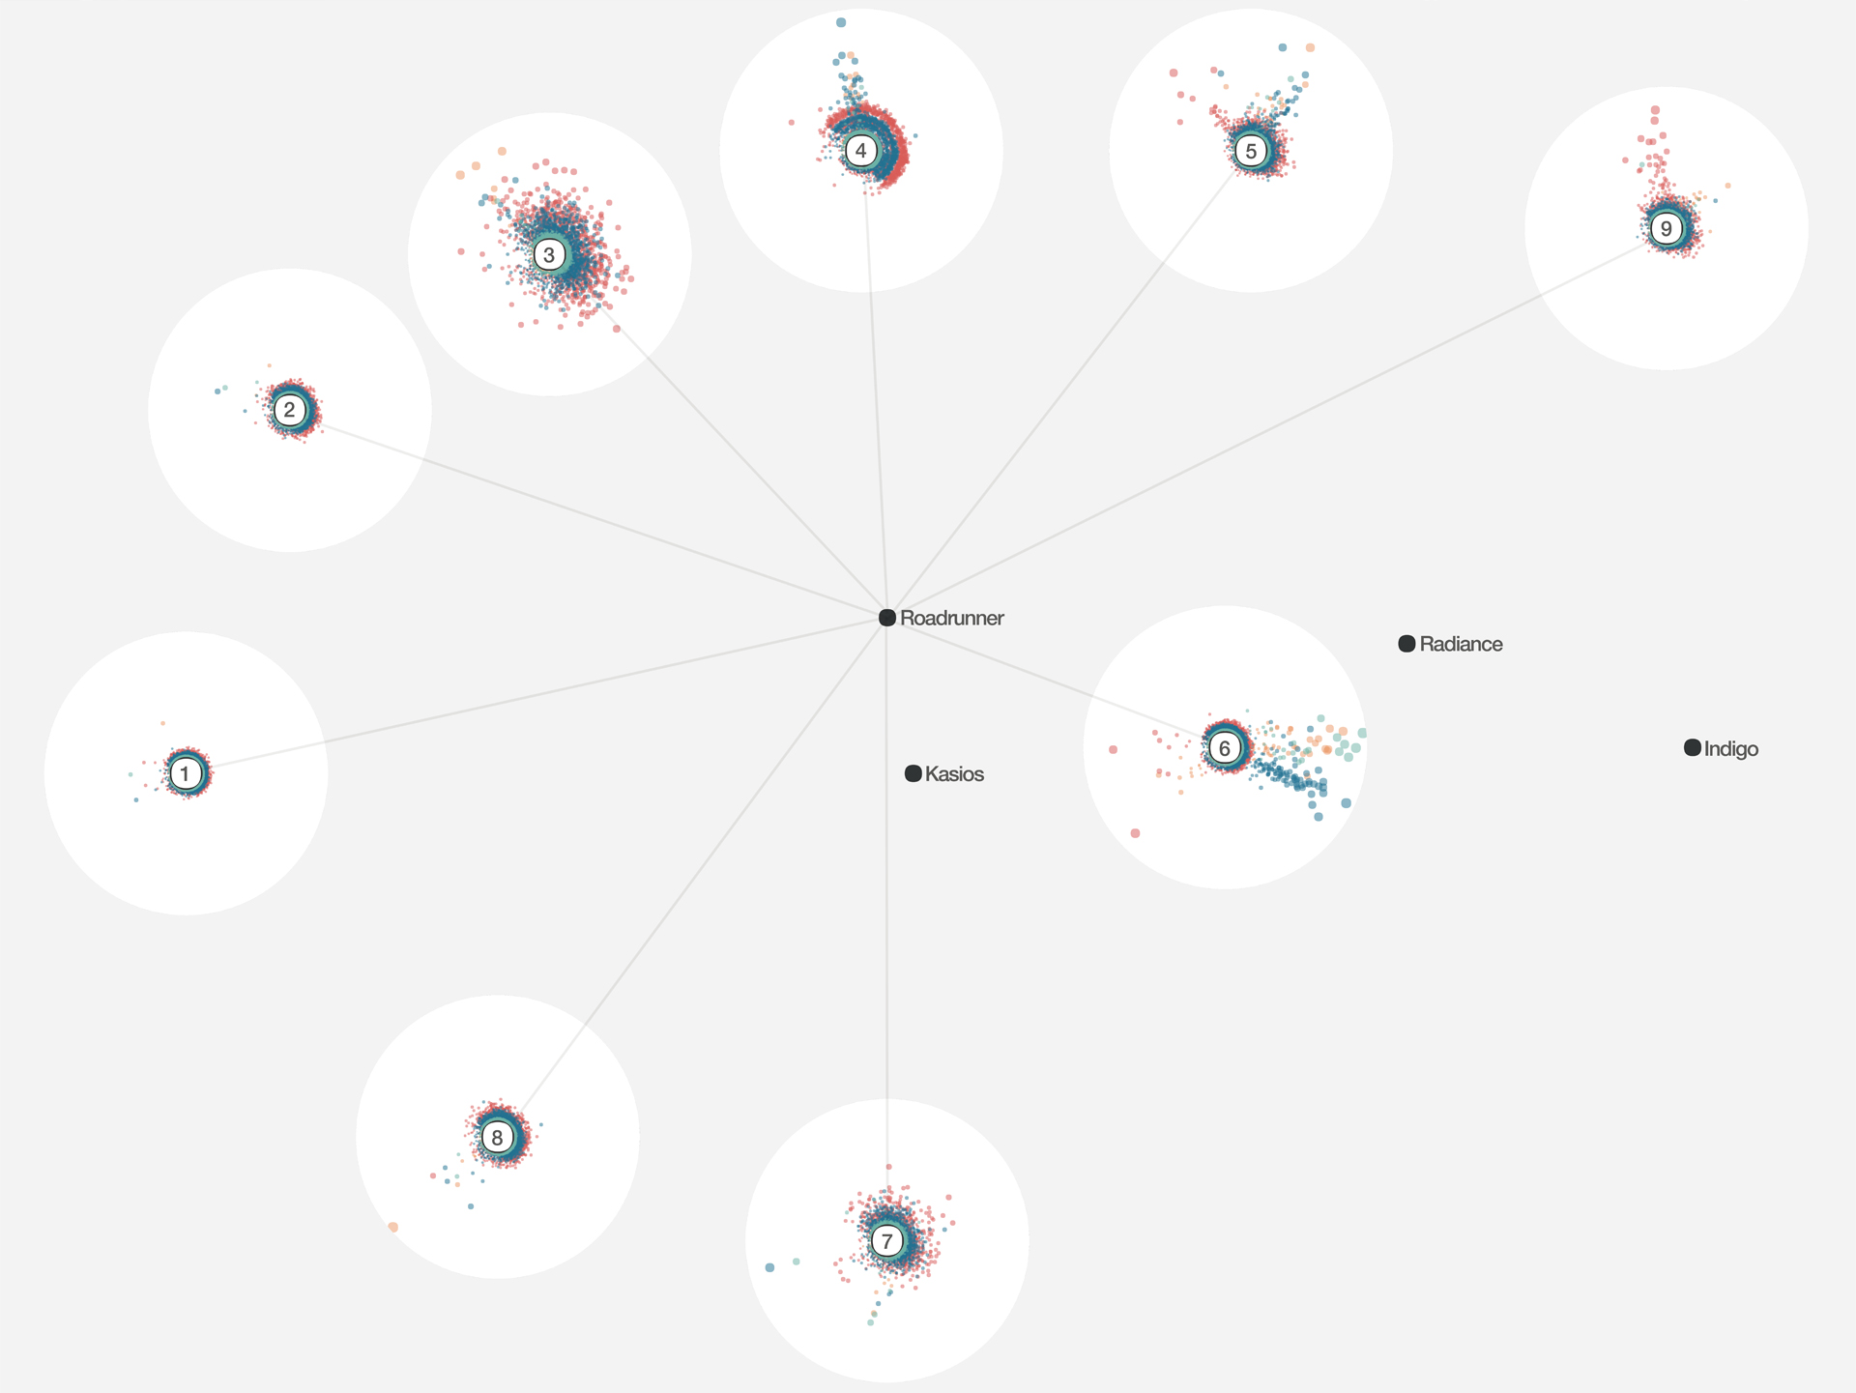
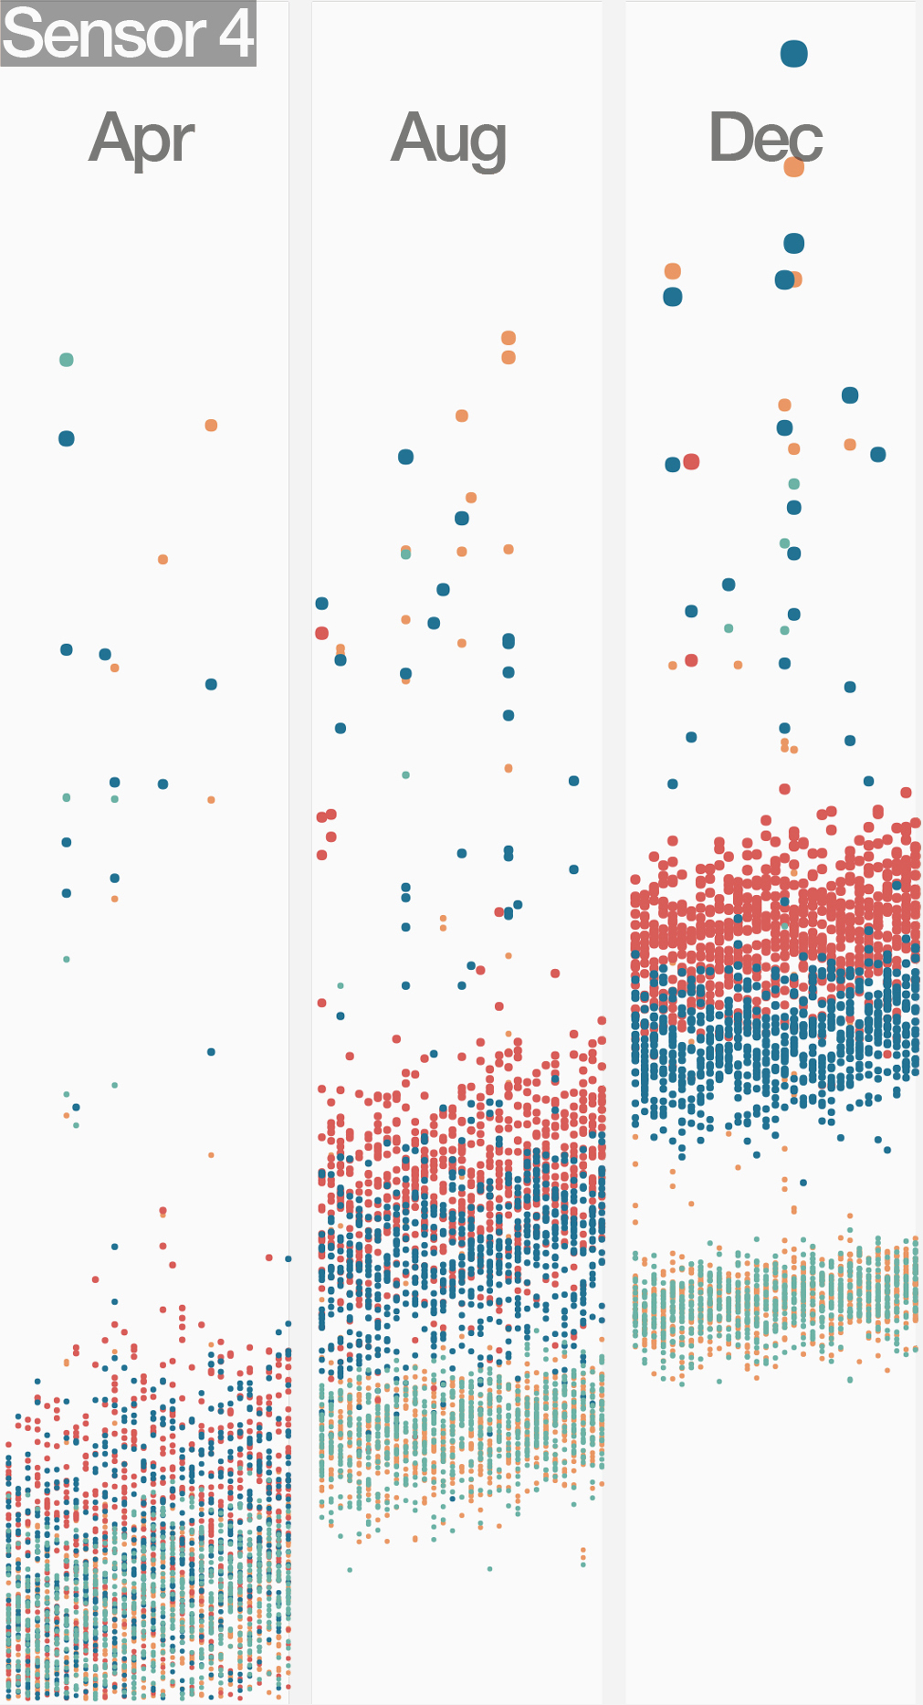
Our solution - WindNebula
To Blend variables and reveal hidden relations
Variables
Wind speed
Wind direction
Factory location
Sensor location
Pollution reading
also
Attenuation
Malfunction
Misreport

Slide 25
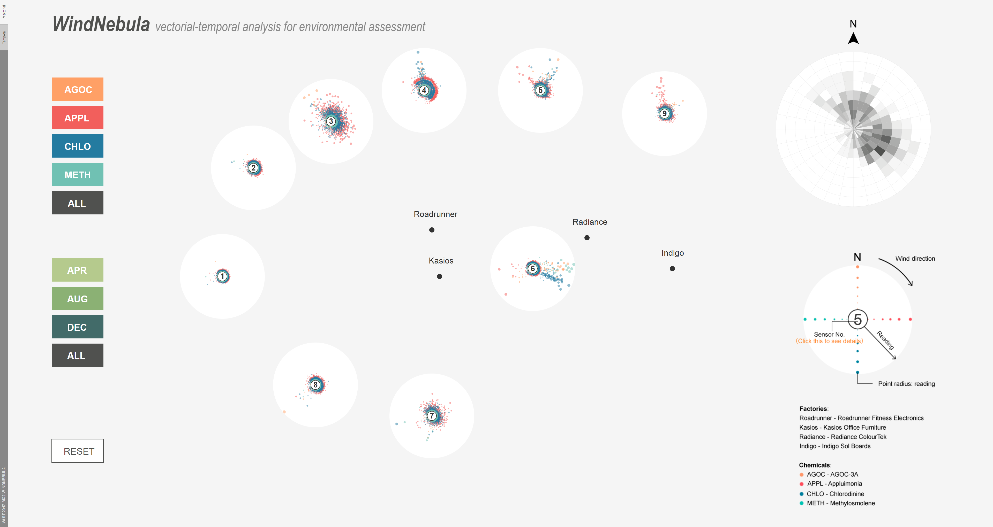
System components
Vectorial view - Overview

Slide 26
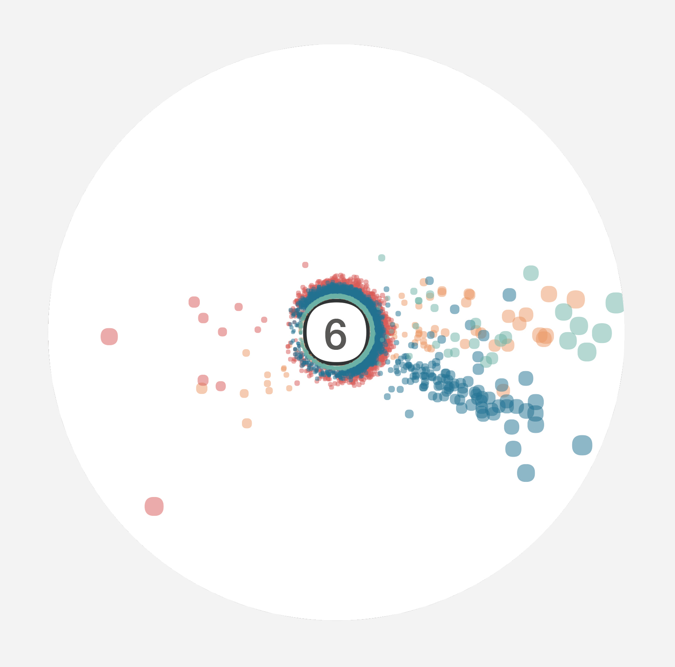
System components
Vectorial view - Nebula
Downwind Direction
Reading Levels

Slide 27
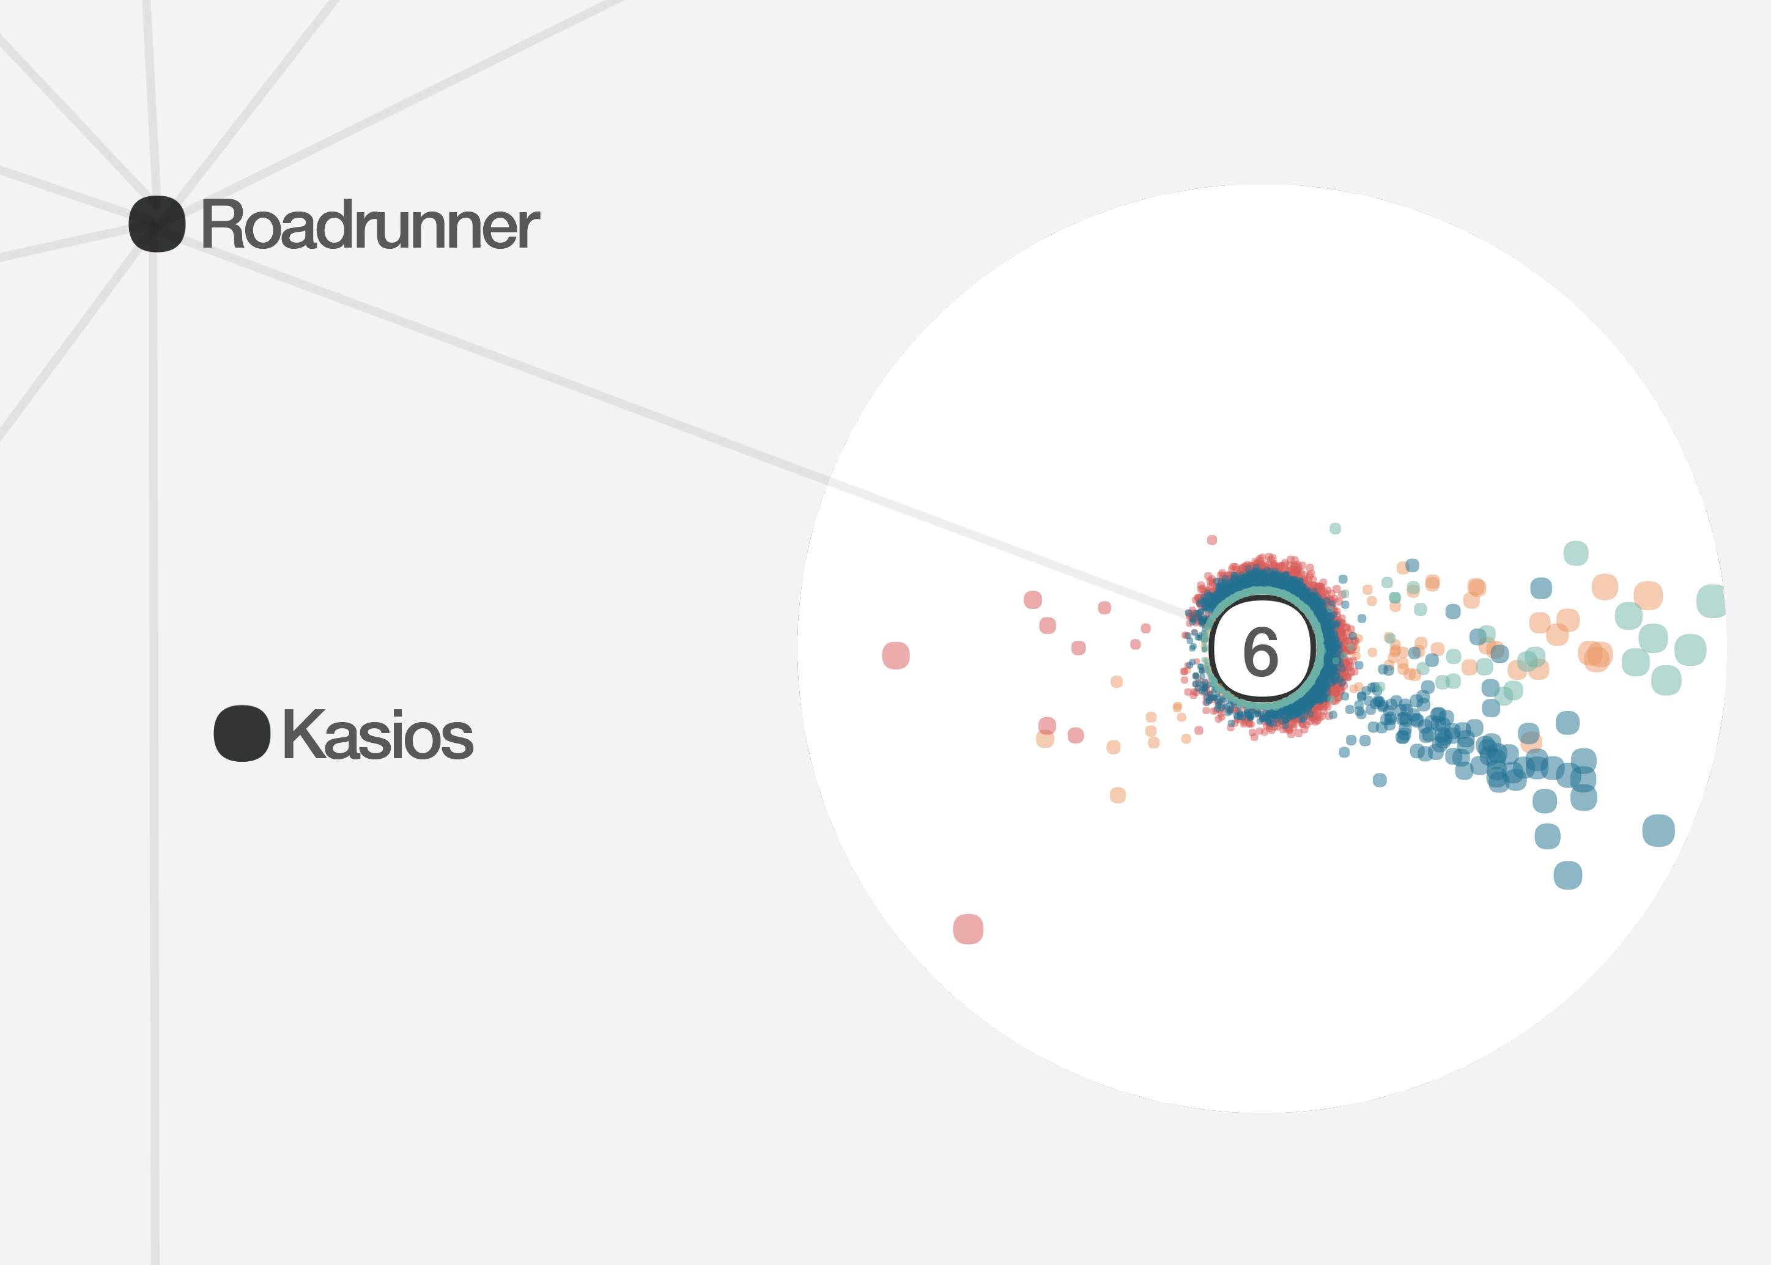
System components
Vectorial view – factory-sensor vectors
Enlarged

Slide 28
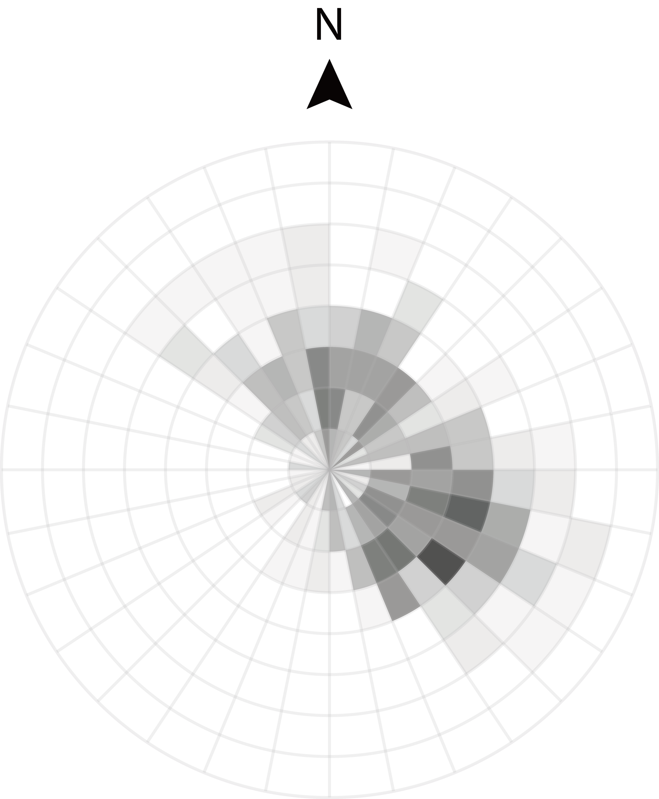
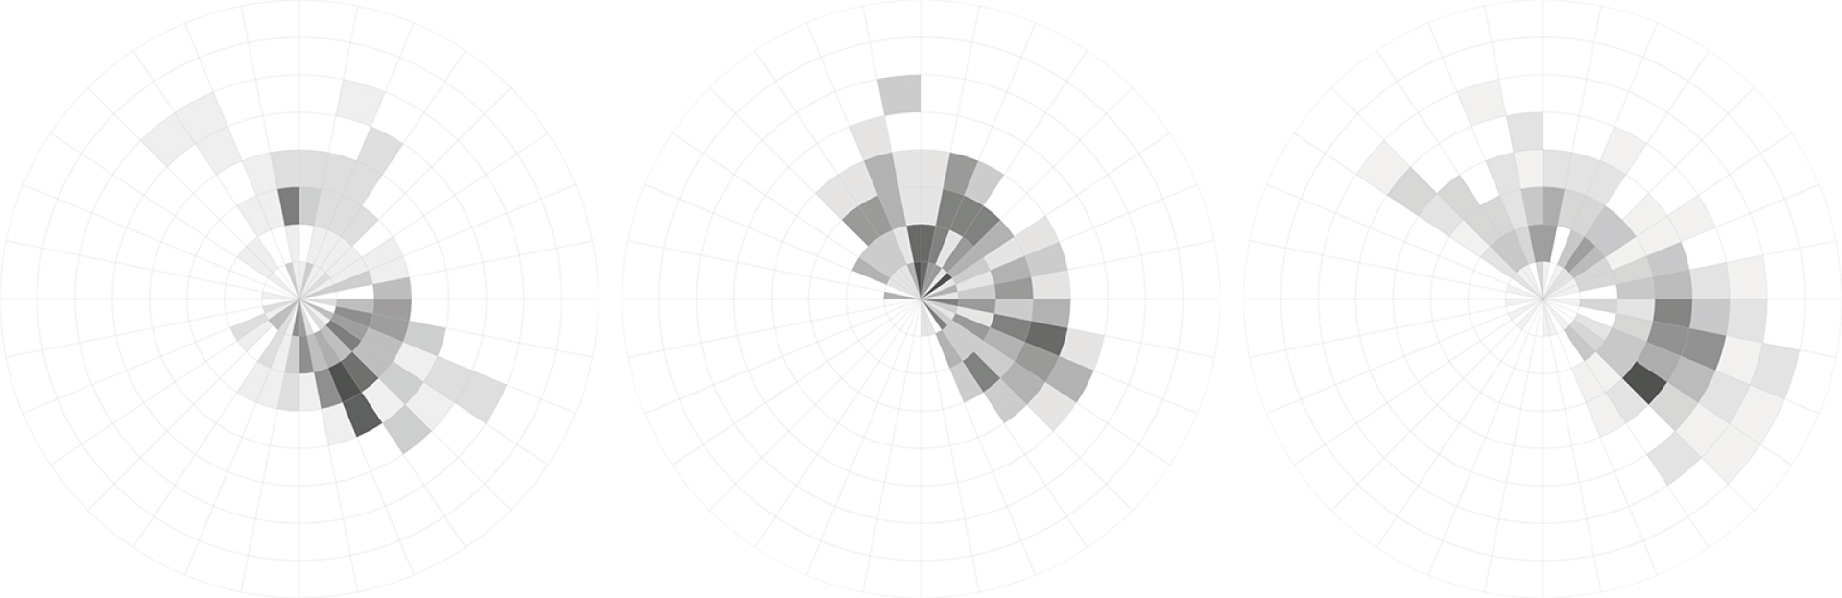
System components
Vectorial view – wind heatmap
April
August
December
Three months combined

Slide 29
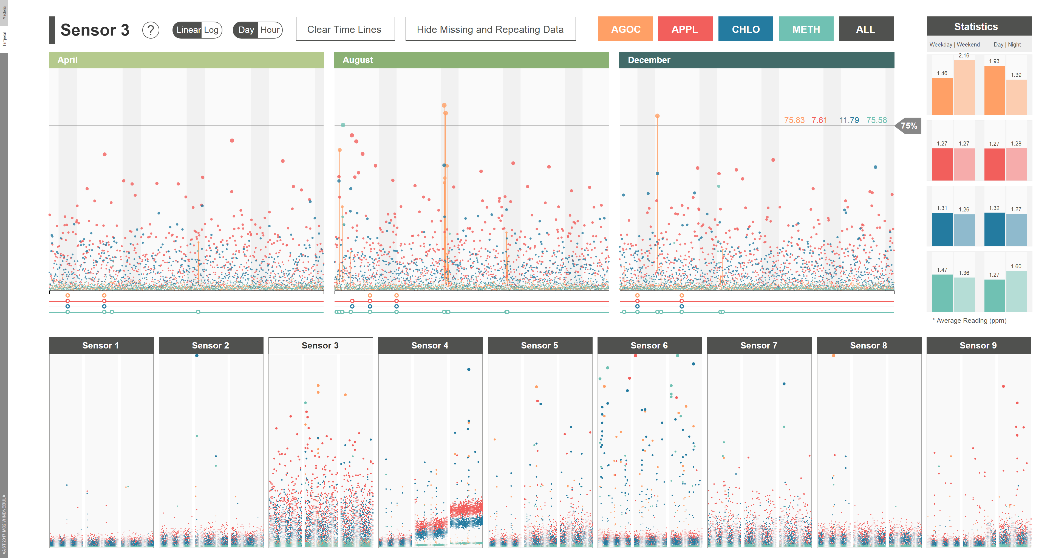
System components
TEMPORAL view – Overview

Slide 30
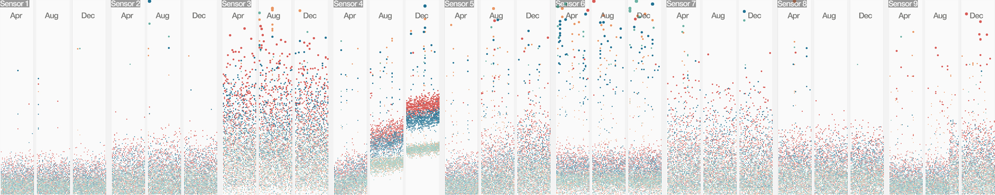
System components
TEMPORAL view – Sensor array

Slide 31
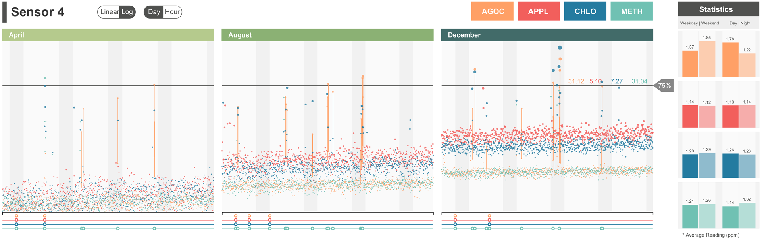
System components
TEMPORAL view – Sensor enlarged view

Slide 32

System components
TEMPORAL view – statistics

Slide 33

System components
Pop-up view – Overview

Slide 34

System components
Pop-up view – DISTILLED Nebula

Slide 35

System components
Pop-up view – Wind Ribbon
April
August
December

Slide 36
System components
Pop-up view

Slide 37











Design process
Overall process
Notes:
For mini challenge 2, we also adopted the iterative design process.

Slide 38
DESIGN Process
Iteration 1
Notes:
At first, we tried to visualize every kind of data we had.
We built a scatter plus boxplot to show the sensor data
We designed a wind ribbon plot to show the wind temporal distribution, also a heat map to show the overall distribution
What’s more, we tried to use regression and gaussian dispersion model to show how pollution spread in the map
However, all the visualization are isolate, so next step we tried to connect this graphs

Slide 39
Design process
Iteration 2
Notes:
Firstly, we put 9 sensor plot together with bar charts to show compare them.
Then, we tried use regression to show the temporal distribution of the chemicals released from the 4 factories
Also, we tried to use brushing and linking to connect sensor readings with wind data.
These are the nine sensors and four chemicals, if we select several big readings of a sensor
We can see their corresponding wind directions.
We discovered some patterns using this design.
But we feel that it’s still not intuitive enough and we won’t get an award by this.

Slide 40



Design process
Final design
Notes:
So we finally found a way to combine all the data
And the patterns and problems are directly shown on the map
As we introduced, we can find which chemical is produced by the direction

Slide 41

Design process
Final design
Notes:
We combined the previous wind ribbon and heat map to show details
Using brushing and linking on single dots to combine them.

Slide 42
Design process
Final design
Notes:
And finally

Slide 43
Aesthetic Design Award
ClockPetals
WindNebula
Zheng Zhou, Hui Tang, Wenjie Wu
Computer Graphics Technology, Purdue University
IEEE VIS 2017 VAST Challenge Workshop
Sunday, October 1st, 2017

